Slide 1
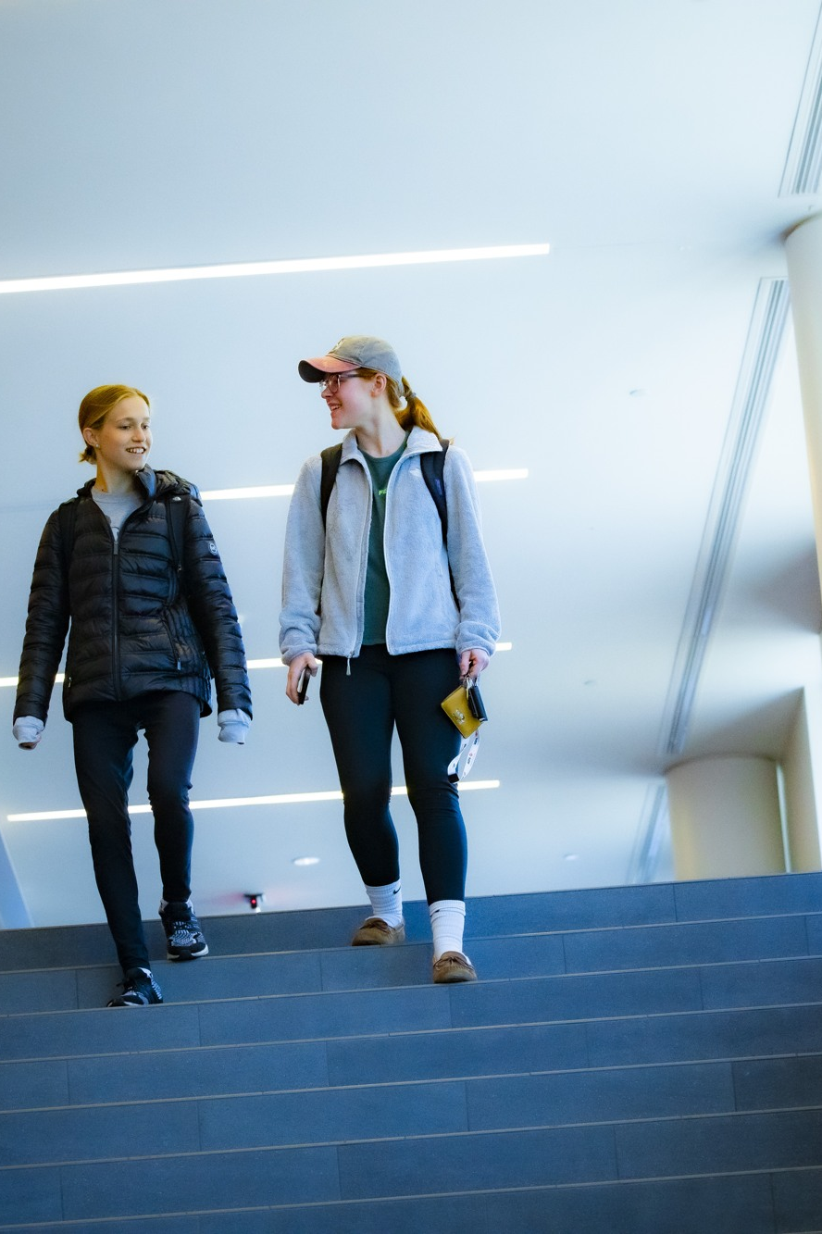

PURSUE YOUR POST-GRADUATE GOALS
Plan Your Graduate
School Applications
Connect your purpose, preparation, and program fit.
Notes:
LESSON: Plan Your Graduate School Applications
SLIDE 1 OF 17
FACILITATOR GUIDE
Learning objectives
Explain a learning or professional reason for considering graduate study.
Verify requirements and deadlines using actual program instructions.
Draft and revise an evidence paragraph tailored to an academic audience.
Plan next steps, alternative routes, and a date to reassess readiness.
Preparation and materials
Read this guide and the linked resources before teaching. Rehearse the worked example. Print the Student planner and make the key terms and feedback checklist available. Prepare a timer, writing space, and A/B/C/D response method. Slides and paid tools are not required. Keep the instructor answer key separate from student materials.
Background for a first time facilitator
Read these terms before class. Introduce them with a short example rather than assuming students know the vocabulary. The teaching suggestions and fictional cases are instructional adaptations, not records of actual outcomes.
SOURCE GUIDE
/Users/wj85/.codex/outputs/career-readiness-lessons/complete-library/14-graduate-school-facilitator-guide.docx
SOURCES
https://careers.rutgers.edu/news/authoring-your-value-personal-statement
https://careers.rutgers.edu/news/timeline-planning-and-applying-graduate-or-professional-school
https://careers.rutgers.edu/students-alumni/career-internship-guide
https://careers.rutgers.edu/students-and-alumni
PHOTO
/Users/wj85/Library/CloudStorage/OneDrive-RutgersUniversity/0 - Shared Department Files/Department-wide/Communications and Marketing/Photo Library/Rutgers (R-Comm)/RG22_10_19_0309_RU_NwBrnswck.JPG
Photograph is illustrative. People shown are not the fictional case participants.
DELIVERY
Move directly to the opening student activity after a brief welcome. Full instructions, worksheets, and accessibility alternatives are in the matching facilitator guide. This deck uses CES branding only.

Slide 2
Your reason and your question
“Further study might help me learn or do…”
“Before applying, I need to find out…”
Think or write first. Then compare with a partner.
Notes:
LESSON: Plan Your Graduate School Applications
SLIDE 2 OF 17
SESSION TIMING: 0–5 minutes
FACILITATOR GUIDE
0 to 5 minutes Opening challenge
Facilitator actions:
Read the prompt below. Give one minute to think, two minutes for partners to try it, and two minutes to hear two observations. Start with participation before explaining the framework.
Say to students:
“Complete two sentences: “Further study might help me learn or do ___” and “Before applying, I need to find out ___.” Compare with a partner. Using a fictional goal is fine; deciding against immediate study is also an outcome.”
Ask students:
“What did you notice, and what would help you improve your next attempt?”
Expected responses:
A specific observation about the task, a choice, or a gap in information.
If students need support:
For “I want any graduate degree,” ask what learning or professional goal requires further investigation. For generic praise of a university, ask which verified feature connects to the student’s goals. For uncertain requirements, consult the program’s official admissions source; do not guess. Never require public disclosure of finances, grades, or personal history.
Transition to the next activity:
“Let us add language and a method that can help with the next attempt.”
SOURCE GUIDE
/Users/wj85/.codex/outputs/career-readiness-lessons/complete-library/14-graduate-school-facilitator-guide.docx
SOURCES
https://careers.rutgers.edu/news/authoring-your-value-personal-statement
https://careers.rutgers.edu/news/timeline-planning-and-applying-graduate-or-professional-school
https://careers.rutgers.edu/students-alumni/career-internship-guide
https://careers.rutgers.edu/students-and-alumni

Slide 3
A graduate-school plan
01
02
03
PURPOSE
PROGRAM FIT
PREPARATION
What learning or professional goal could further study support?
Which actual curriculum, methods, or opportunities fit?
What evidence shows your readiness and what must you develop?
03
Notes:
LESSON: Plan Your Graduate School Applications
SLIDE 3 OF 17
SESSION TIMING: 5–12 minutes
FACILITATOR GUIDE
Background for a first time facilitator
Read these terms before class. Introduce them with a short example rather than assuming students know the vocabulary. The teaching suggestions and fictional cases are instructional adaptations, not records of actual outcomes.
A short explanation you can use
Say to students:
“Graduate-school planning starts with purpose and program fit, then moves to the actual application process. Read each program’s instructions; do not assume every program requires the same test or document. Explain what your experience taught you and why it prepares you for the academic work you seek. Plan time for drafts, feedback, recommendations, and submission checks.”
Key terms:
Program fit: A connection between your learning goals and a program’s actual curriculum, methods, supervision, or opportunities.
Requirement: An instruction set by the particular program; tests, documents, and dates vary.
Personal statement: An application response whose purpose and content depend on the actual prompt.
Evidence of preparation: Specific learning, inquiry, contributions, and reflection supporting readiness for further study.
Backward timeline: A schedule built from the verified deadline back to preparation steps and dependencies.
SOURCE GUIDE
/Users/wj85/.codex/outputs/career-readiness-lessons/complete-library/14-graduate-school-facilitator-guide.docx
SOURCES
https://careers.rutgers.edu/news/authoring-your-value-personal-statement
https://careers.rutgers.edu/news/timeline-planning-and-applying-graduate-or-professional-school
https://careers.rutgers.edu/students-alumni/career-internship-guide
https://careers.rutgers.edu/students-and-alumni

Slide 4
Program-specific requirements
01
02
03
VERIFY
WORK BACKWARD
KEEP OPTIONS
Use each program’s current official instructions.
Plan recommendations, drafts, feedback, and submission checks.
Consider timing, a second program, and adjacent work or learning.
04
Notes:
LESSON: Plan Your Graduate School Applications
SLIDE 4 OF 17
SESSION TIMING: 5–12 minutes
FACILITATOR GUIDE
Background for a first time facilitator
Read these terms before class. Introduce them with a short example rather than assuming students know the vocabulary. The teaching suggestions and fictional cases are instructional adaptations, not records of actual outcomes.
A short explanation you can use
Say to students:
“Graduate-school planning starts with purpose and program fit, then moves to the actual application process. Read each program’s instructions; do not assume every program requires the same test or document. Explain what your experience taught you and why it prepares you for the academic work you seek. Plan time for drafts, feedback, recommendations, and submission checks.”
Key terms:
Program fit: A connection between your learning goals and a program’s actual curriculum, methods, supervision, or opportunities.
Requirement: An instruction set by the particular program; tests, documents, and dates vary.
Personal statement: An application response whose purpose and content depend on the actual prompt.
Evidence of preparation: Specific learning, inquiry, contributions, and reflection supporting readiness for further study.
Backward timeline: A schedule built from the verified deadline back to preparation steps and dependencies.
SOURCE GUIDE
/Users/wj85/.codex/outputs/career-readiness-lessons/complete-library/14-graduate-school-facilitator-guide.docx
SOURCES
https://careers.rutgers.edu/news/authoring-your-value-personal-statement
https://careers.rutgers.edu/news/timeline-planning-and-applying-graduate-or-professional-school
https://careers.rutgers.edu/students-alumni/career-internship-guide
https://careers.rutgers.edu/students-and-alumni

Slide 5
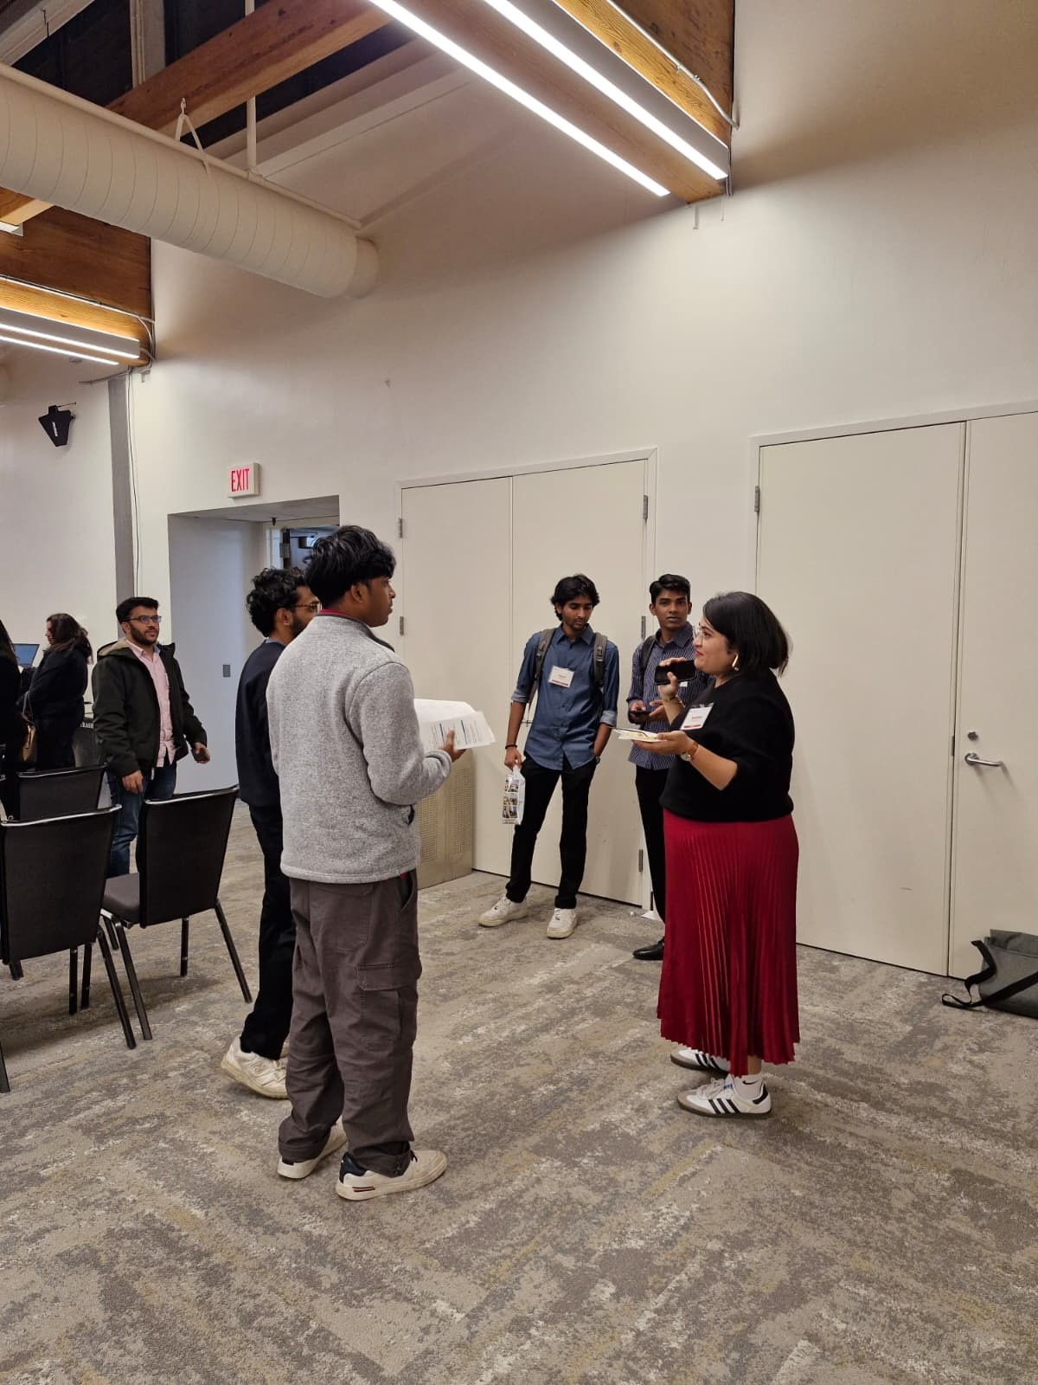
A fictional case
THE ASSUMPTION
Jordan wants environmental policy study but reuses a generic leadership statement.
THE MISSING STEP
Jordan assumes shared deadlines and tests. Each program needs a separate check.
THE OPPORTUNITY
Jordan’s policy project shows evidence evaluation and revision worth explaining.
05
Notes:
LESSON: Plan Your Graduate School Applications
SLIDE 5 OF 17
SESSION TIMING: 12–20 minutes
FACILITATOR GUIDE
12 to 20 minutes Shared case
Read aloud:
Jordan wants to study environmental policy, copies a generic statement about leadership, and assumes two programs share a deadline and test requirement. Jordan’s class project involved evaluating evidence and revising a policy argument, but the statement never explains that preparation or the programs’ differences.
Facilitator actions:
Give pairs three minutes to identify a gap and recommend a change. Use three minutes to hear two recommendations and explain the answer guidance. Spend the final two minutes modeling a revised response or the worked example.
Ask students:
“What is missing? What evidence or information would help? What would you change first?”
Answer guidance:
Check each official program page and record its prompt, requirements, deadline, and unresolved questions. Use the project to explain inquiry, revision, and learning connected to academic interests. A leadership label alone does not establish program fit. Requirements not confirmed should be marked as questions, not treated as facts.
Original case:
Jordan wants to study environmental policy, copies a generic statement about leadership, and assumes two programs share a deadline and test requirement. Jordan’s class project involved evaluating evidence and revising a policy argument, but the statement never explains that preparation or the programs’ differences.
Allow pair discussion before showing the next slide.
SOURCE GUIDE
/Users/wj85/.codex/outputs/career-readiness-lessons/complete-library/14-graduate-school-facilitator-guide.docx
SOURCES
https://careers.rutgers.edu/news/authoring-your-value-personal-statement
https://careers.rutgers.edu/news/timeline-planning-and-applying-graduate-or-professional-school
https://careers.rutgers.edu/students-alumni/career-internship-guide
https://careers.rutgers.edu/students-and-alumni
PHOTO
/Users/wj85/Library/CloudStorage/OneDrive-RutgersUniversity/0 - Shared Department Files/Department-wide/Communications and Marketing/Photo Library/2025-2026 Academic Year/Beyond Your Graduate Degree_Grad Student Event/Beyond Your Degree20.jpeg
Photograph is illustrative. People shown are not the fictional case participants.

Slide 6
Case discussion
01
02
03
FIT NEEDS DETAIL
EVIDENCE NEEDS ACTION
A TIMELINE NEEDS CHECKS
Name the learning connection, not only the program’s reputation.
Explain a contribution, insight, and a question you want to pursue.
Leave time for feedback, recommendations, and final review.
06
Notes:
LESSON: Plan Your Graduate School Applications
SLIDE 6 OF 17
SESSION TIMING: 12–20 minutes
FACILITATOR GUIDE
Check each official program page and record its prompt, requirements, deadline, and unresolved questions. Use the project to explain inquiry, revision, and learning connected to academic interests. A leadership label alone does not establish program fit. Requirements not confirmed should be marked as questions, not treated as facts.
12 to 20 minutes Shared case
Read aloud:
Jordan wants to study environmental policy, copies a generic statement about leadership, and assumes two programs share a deadline and test requirement. Jordan’s class project involved evaluating evidence and revising a policy argument, but the statement never explains that preparation or the programs’ differences.
Facilitator actions:
Give pairs three minutes to identify a gap and recommend a change. Use three minutes to hear two recommendations and explain the answer guidance. Spend the final two minutes modeling a revised response or the worked example.
Ask students:
“What is missing? What evidence or information would help? What would you change first?”
Answer guidance:
Check each official program page and record its prompt, requirements, deadline, and unresolved questions. Use the project to explain inquiry, revision, and learning connected to academic interests. A leadership label alone does not establish program fit. Requirements not confirmed should be marked as questions, not treated as facts.
SOURCE GUIDE
/Users/wj85/.codex/outputs/career-readiness-lessons/complete-library/14-graduate-school-facilitator-guide.docx
SOURCES
https://careers.rutgers.edu/news/authoring-your-value-personal-statement
https://careers.rutgers.edu/news/timeline-planning-and-applying-graduate-or-professional-school
https://careers.rutgers.edu/students-alumni/career-internship-guide
https://careers.rutgers.edu/students-and-alumni

Slide 7
Your student planner
01
02
03
COMPARE AND VERIFY
DRAFT EVIDENCE
BUILD A TIMELINE
Choose programs and record their actual requirements.
Explain your preparation and its connection to a learning goal.
Work backward from verified dates. Include an alternative route.
Use the matching Student planner in the facilitator guide.
07
Notes:
LESSON: Plan Your Graduate School Applications
SLIDE 7 OF 17
SESSION TIMING: 20–35 minutes
FACILITATOR GUIDE
20 to 35 minutes Main activity
Facilitator actions:
Use the Graduate application planner. Spend four minutes choosing a program or fictional example and verifying instructions, five drafting an evidence paragraph, three building a backward timeline, and three identifying alternatives. If using a fictional program, clearly label its requirements as exercise data rather than guidance for an actual institution.
Say to students:
“Create a first draft using the planner. Mark anything you do not know instead of inventing a fact. You will receive feedback and revise.”
Coaching guidance:
For “I want any graduate degree,” ask what learning or professional goal requires further investigation. For generic praise of a university, ask which verified feature connects to the student’s goals. For uncertain requirements, consult the program’s official admissions source; do not guess. Never require public disclosure of finances, grades, or personal history.
Transition to the next activity:
“Choose the part of your draft you most want a listener to test.”
WORKSHEET PROMPTS
Why further study, and why this field or program? Identify a curriculum, method, or academic interest to verify.
Record the official program URL, date checked, prompt, deadline, materials, and any test or recommendation requirements. Mark unknowns.
Describe one preparation experience: your contribution, what you learned, and its relevance to further study. Draft a paragraph answering the actual prompt.
Build a timeline for verification, requesting recommendations, drafts, feedback, and final checks. Identify dependencies and a person to consult.
Plan A, another program or timing option, and an adjacent work or learning route. What would prompt reassessing readiness or plans?
SOURCE GUIDE
/Users/wj85/.codex/outputs/career-readiness-lessons/complete-library/14-graduate-school-facilitator-guide.docx
SOURCES
https://careers.rutgers.edu/news/authoring-your-value-personal-statement
https://careers.rutgers.edu/news/timeline-planning-and-applying-graduate-or-professional-school
https://careers.rutgers.edu/students-alumni/career-internship-guide
https://careers.rutgers.edu/students-and-alumni

Slide 8
A worked response
In a class policy project, I compared evidence from several sources and revised an argument after feedback exposed a weak assumption. I learned to separate the strength of a claim from my initial preference. I want to develop more rigorous policy-evaluation methods through further study. I would connect this preparation to a verified feature of the specific program rather than add a generic claim of fit.
What makes the response specific? What would you adapt?
08
Notes:
LESSON: Plan Your Graduate School Applications
SLIDE 8 OF 17
SESSION TIMING: 20–35 minutes
FACILITATOR GUIDE
A worked response
In a class policy project, I compared evidence from several sources and revised an argument after feedback exposed a weak assumption. I learned to separate the strength of a claim from my initial preference. I want to develop more rigorous policy-evaluation methods through further study. I would connect this preparation to a verified feature of the specific program rather than add a generic claim of fit.
In a class policy project, I compared evidence from several sources and revised an argument after feedback exposed a weak assumption. I learned to separate the strength of a claim from my initial preference. I want to develop more rigorous policy-evaluation methods through further study. I would connect this preparation to a verified feature of the specific program rather than add a generic claim of fit.
SOURCE GUIDE
/Users/wj85/.codex/outputs/career-readiness-lessons/complete-library/14-graduate-school-facilitator-guide.docx
SOURCES
https://careers.rutgers.edu/news/authoring-your-value-personal-statement
https://careers.rutgers.edu/news/timeline-planning-and-applying-graduate-or-professional-school
https://careers.rutgers.edu/students-alumni/career-internship-guide
https://careers.rutgers.edu/students-and-alumni

Slide 9
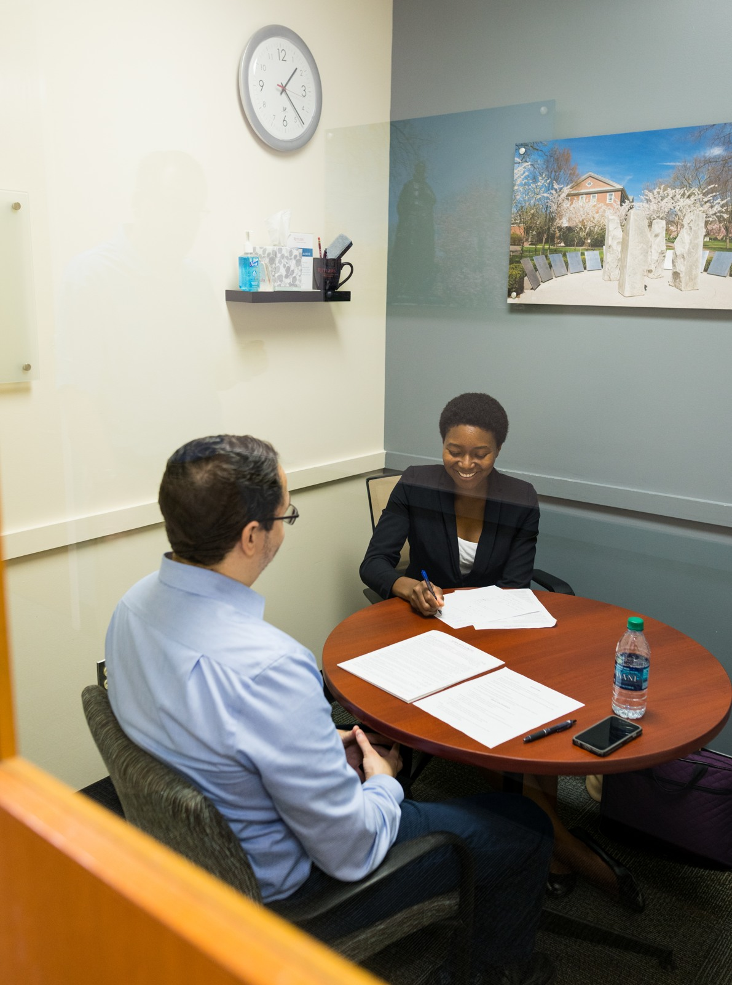
Feedback and revision
WHAT IS CLEAR
Name one specific detail that supports the response.
WHAT NEEDS WORK
Identify one missing piece or unsupported assumption.
WHAT CHANGES
Agree on one revision, then try again.
09
Notes:
LESSON: Plan Your Graduate School Applications
SLIDE 9 OF 17
SESSION TIMING: 35–50 minutes
FACILITATOR GUIDE
35 to 50 minutes Individual feedback and revision
Facilitator actions:
35–39: Partner A explains or role-plays the draft for two minutes; Partner B gives two minutes of specific feedback using the checklist below. 39–43: Swap. 43–46: Both revise. 46–50: Each gives a two-minute revised attempt. Use the role instructions below for the listener.
Say to students:
“Identify one detail that works, one question you still have, and one change the speaker can make. Respond to the actual draft, then listen for the change in the second attempt.”
Listener role: Act as a reviewer or advisor. Ask the speaker to explain their reasoning and point out information that needs clarification.
Feedback sentence: “The detail ___ helped because ___. I still need to understand ___. Try changing ___.”
Review checks:
Does the paragraph answer the actual prompt?
Is the student’s contribution and learning specific?
Is the academic connection supported by verified program information?
Are requirements, dependencies, and alternative routes visible?
Coaching:
For “I want any graduate degree,” ask what learning or professional goal requires further investigation. For generic praise of a university, ask which verified feature connects to the student’s goals. For uncertain requirements, consult the program’s official admissions source; do not guess. Never require public disclosure of finances, grades, or personal history.
SOURCE GUIDE
/Users/wj85/.codex/outputs/career-readiness-lessons/complete-library/14-graduate-school-facilitator-guide.docx
SOURCES
https://careers.rutgers.edu/news/authoring-your-value-personal-statement
https://careers.rutgers.edu/news/timeline-planning-and-applying-graduate-or-professional-school
https://careers.rutgers.edu/students-alumni/career-internship-guide
https://careers.rutgers.edu/students-and-alumni
PHOTO
/Users/wj85/Desktop/Dropbox/Rutgers Work/Marketing & Communications/Marketing Items/Photos/2017-2018 Acamdemic Year/Fall 2017/100917_Mock Interview Clinic/DSC04439.JPG
Photograph is illustrative. People shown are not the fictional case participants.

Slide 10
Both partners get a second attempt
01
02
03
ROUND ONE
SWAP ROLES
REVISE AND RETRY
Partner A explains or role-plays. Partner B gives specific feedback.
Partner B explains or role-plays. Partner A gives feedback.
Both apply one suggestion and repeat the key response.
10
Notes:
LESSON: Plan Your Graduate School Applications
SLIDE 10 OF 17
SESSION TIMING: 35–50 minutes
FACILITATOR GUIDE
35 to 50 minutes Individual feedback and revision
Facilitator actions:
35–39: Partner A explains or role-plays the draft for two minutes; Partner B gives two minutes of specific feedback using the checklist below. 39–43: Swap. 43–46: Both revise. 46–50: Each gives a two-minute revised attempt. Use the role instructions below for the listener.
Say to students:
“Identify one detail that works, one question you still have, and one change the speaker can make. Respond to the actual draft, then listen for the change in the second attempt.”
Listener role: Act as a reviewer or advisor. Ask the speaker to explain their reasoning and point out information that needs clarification.
Feedback sentence: “The detail ___ helped because ___. I still need to understand ___. Try changing ___.”
Use the role and deliverable specified in the guide. A written exchange, recorded response, or private practice can provide an equivalent feedback-and-revision cycle.
SOURCE GUIDE
/Users/wj85/.codex/outputs/career-readiness-lessons/complete-library/14-graduate-school-facilitator-guide.docx
SOURCES
https://careers.rutgers.edu/news/authoring-your-value-personal-statement
https://careers.rutgers.edu/news/timeline-planning-and-applying-graduate-or-professional-school
https://careers.rutgers.edu/students-alumni/career-internship-guide
https://careers.rutgers.edu/students-and-alumni

Slide 11
Knowledge check 1
Which source determines a program’s application requirements?
A
A friend’s requirements elsewhere
B
An old generic checklist
C
That program’s current official instructions
D
The same rules for every field
11
Notes:
LESSON: Plan Your Graduate School Applications
SLIDE 11 OF 17
SESSION TIMING: Closing reinforcement
FACILITATOR GUIDE
50 to 58 minutes Closing challenge
Use four quiz questions from the instructor key: allow about 30 seconds to choose and 30 seconds to explain each answer, four minutes total. Then use four minutes for an adaptation challenge: two minutes to write a change and two minutes to compare with a partner.
Adaptation prompt:
“Your preferred opportunity is paused or its requirements change. Use your Plan B or adjacent route to choose a next action while preserving what matters to you. Explain how a first destination could support later movement.”
INSTRUCTOR ANSWER KEY
Correct answer: C. That program’s current official instructions
Explanation: Requirements are program-specific and should be verified.
Accept A/B/C/D cards, fingers, chat, polling, or a Kahoot created from these items. Ask for a rationale before giving feedback. Answers are in notes only.
SOURCE GUIDE
/Users/wj85/.codex/outputs/career-readiness-lessons/complete-library/14-graduate-school-facilitator-guide.docx
SOURCES
https://careers.rutgers.edu/news/authoring-your-value-personal-statement
https://careers.rutgers.edu/news/timeline-planning-and-applying-graduate-or-professional-school
https://careers.rutgers.edu/students-alumni/career-internship-guide
https://careers.rutgers.edu/students-and-alumni

Slide 12
Knowledge check 2
Which paragraph best supports academic readiness?
A
Specific contribution and learning connected to academic goals
B
A list of flattering adjectives
C
An invented research result
D
An unrelated generic pitch
12
Notes:
LESSON: Plan Your Graduate School Applications
SLIDE 12 OF 17
SESSION TIMING: Closing reinforcement
FACILITATOR GUIDE
50 to 58 minutes Closing challenge
Use four quiz questions from the instructor key: allow about 30 seconds to choose and 30 seconds to explain each answer, four minutes total. Then use four minutes for an adaptation challenge: two minutes to write a change and two minutes to compare with a partner.
Adaptation prompt:
“Your preferred opportunity is paused or its requirements change. Use your Plan B or adjacent route to choose a next action while preserving what matters to you. Explain how a first destination could support later movement.”
INSTRUCTOR ANSWER KEY
Correct answer: A. Specific contribution and learning connected to academic goals
Explanation: The reader needs evidence and a relevant connection.
Accept A/B/C/D cards, fingers, chat, polling, or a Kahoot created from these items. Ask for a rationale before giving feedback. Answers are in notes only.
SOURCE GUIDE
/Users/wj85/.codex/outputs/career-readiness-lessons/complete-library/14-graduate-school-facilitator-guide.docx
SOURCES
https://careers.rutgers.edu/news/authoring-your-value-personal-statement
https://careers.rutgers.edu/news/timeline-planning-and-applying-graduate-or-professional-school
https://careers.rutgers.edu/students-alumni/career-internship-guide
https://careers.rutgers.edu/students-and-alumni

Slide 13
Knowledge check 3
What belongs in a backward timeline?
A
Only the final deadline
B
Preparation steps, dependencies, feedback, and verified dates
C
An assumed testing rule
D
A promise of admission
13
Notes:
LESSON: Plan Your Graduate School Applications
SLIDE 13 OF 17
SESSION TIMING: Closing reinforcement
FACILITATOR GUIDE
50 to 58 minutes Closing challenge
Use four quiz questions from the instructor key: allow about 30 seconds to choose and 30 seconds to explain each answer, four minutes total. Then use four minutes for an adaptation challenge: two minutes to write a change and two minutes to compare with a partner.
Adaptation prompt:
“Your preferred opportunity is paused or its requirements change. Use your Plan B or adjacent route to choose a next action while preserving what matters to you. Explain how a first destination could support later movement.”
INSTRUCTOR ANSWER KEY
Correct answer: B. Preparation steps, dependencies, feedback, and verified dates
Explanation: Applications involve linked steps before submission.
Accept A/B/C/D cards, fingers, chat, polling, or a Kahoot created from these items. Ask for a rationale before giving feedback. Answers are in notes only.
SOURCE GUIDE
/Users/wj85/.codex/outputs/career-readiness-lessons/complete-library/14-graduate-school-facilitator-guide.docx
SOURCES
https://careers.rutgers.edu/news/authoring-your-value-personal-statement
https://careers.rutgers.edu/news/timeline-planning-and-applying-graduate-or-professional-school
https://careers.rutgers.edu/students-alumni/career-internship-guide
https://careers.rutgers.edu/students-and-alumni

Slide 14
Knowledge check 4
What does an alternative route accomplish?
A
Guarantees admission
B
Proves the original goal was wrong
C
Makes verification unnecessary
D
Preserves options as readiness, information, or circumstances change
14
Notes:
LESSON: Plan Your Graduate School Applications
SLIDE 14 OF 17
SESSION TIMING: Closing reinforcement
FACILITATOR GUIDE
50 to 58 minutes Closing challenge
Use four quiz questions from the instructor key: allow about 30 seconds to choose and 30 seconds to explain each answer, four minutes total. Then use four minutes for an adaptation challenge: two minutes to write a change and two minutes to compare with a partner.
Adaptation prompt:
“Your preferred opportunity is paused or its requirements change. Use your Plan B or adjacent route to choose a next action while preserving what matters to you. Explain how a first destination could support later movement.”
INSTRUCTOR ANSWER KEY
Correct answer: D. Preserves options as readiness, information, or circumstances change
Explanation: The first destination or timeline need not determine every future step.
Accept A/B/C/D cards, fingers, chat, polling, or a Kahoot created from these items. Ask for a rationale before giving feedback. Answers are in notes only.
SOURCE GUIDE
/Users/wj85/.codex/outputs/career-readiness-lessons/complete-library/14-graduate-school-facilitator-guide.docx
SOURCES
https://careers.rutgers.edu/news/authoring-your-value-personal-statement
https://careers.rutgers.edu/news/timeline-planning-and-applying-graduate-or-professional-school
https://careers.rutgers.edu/students-alumni/career-internship-guide
https://careers.rutgers.edu/students-and-alumni

Slide 15
An adaptation challenge
A program requires an additional document or your timeline changes. What dependencies and alternatives would you revise?
Explain what you would change and why. Then revise your plan.
Notes:
LESSON: Plan Your Graduate School Applications
SLIDE 15 OF 17
SESSION TIMING: 54–58 minutes
FACILITATOR GUIDE
50 to 58 minutes Closing challenge
Use four quiz questions from the instructor key: allow about 30 seconds to choose and 30 seconds to explain each answer, four minutes total. Then use four minutes for an adaptation challenge: two minutes to write a change and two minutes to compare with a partner.
Adaptation prompt:
“Your preferred opportunity is paused or its requirements change. Use your Plan B or adjacent route to choose a next action while preserving what matters to you. Explain how a first destination could support later movement.”
SOURCE GUIDE
/Users/wj85/.codex/outputs/career-readiness-lessons/complete-library/14-graduate-school-facilitator-guide.docx
SOURCES
https://careers.rutgers.edu/news/authoring-your-value-personal-statement
https://careers.rutgers.edu/news/timeline-planning-and-applying-graduate-or-professional-school
https://careers.rutgers.edu/students-alumni/career-internship-guide
https://careers.rutgers.edu/students-and-alumni

Slide 16
Your next step
Your revision
What improved after feedback?
Your action
What specific step will you take?
Your check
When will you review it, and what will you look for?
16
Notes:
LESSON: Plan Your Graduate School Applications
SLIDE 16 OF 17
SESSION TIMING: 58–60 minutes
FACILITATOR GUIDE
58 to 60 minutes Exit commitment
Collect the revised planner, one change made after feedback, and a specific next step with a date. Ask students to name a resource or person they will consult. Close with: “Use what you learned today, check what you still do not know, and revisit the plan after you act.”
SOURCE GUIDE
/Users/wj85/.codex/outputs/career-readiness-lessons/complete-library/14-graduate-school-facilitator-guide.docx
SOURCES
https://careers.rutgers.edu/news/authoring-your-value-personal-statement
https://careers.rutgers.edu/news/timeline-planning-and-applying-graduate-or-professional-school
https://careers.rutgers.edu/students-alumni/career-internship-guide
https://careers.rutgers.edu/students-and-alumni

Slide 17
Resources for your next step
01
CES personal statements
careers.rutgers.edu/news/authoring-your-value-personal-statement
02
CES application planning timeline
careers.rutgers.edu
03
CES Guide
careers.rutgers.edu/students-alumni/career-internship-guide
17
Notes:
LESSON: Plan Your Graduate School Applications
SLIDE 17 OF 17
SESSION TIMING: After the closing commitment
FACILITATOR GUIDE
Resources and follow through
After class, ask students to take their dated step and briefly report what they learned. Use the following resources as starting points; tools, dates, and eligibility should be checked before each delivery. Program and employer instructions control actual requirements.
CES personal statements: https://careers.rutgers.edu/news/authoring-your-value-personal-statement
CES application planning timeline: https://careers.rutgers.edu/news/timeline-planning-and-applying-graduate-or-professional-school
CES Guide: https://careers.rutgers.edu/students-alumni/career-internship-guide
CES advising: https://careers.rutgers.edu/students-and-alumni
Framework reference: Building a Career-Ready Campus taskforce criteria supplied by the user. CES Career Journey descriptions reflect the user’s explanation. Resources checked November 1, 2026. Activities and examples are teaching adaptations.
SOURCE GUIDE
/Users/wj85/.codex/outputs/career-readiness-lessons/complete-library/14-graduate-school-facilitator-guide.docx
SOURCES
https://careers.rutgers.edu/news/authoring-your-value-personal-statement
https://careers.rutgers.edu/news/timeline-planning-and-applying-graduate-or-professional-school
https://careers.rutgers.edu/students-alumni/career-internship-guide
https://careers.rutgers.edu/students-and-alumni

