Slide 1
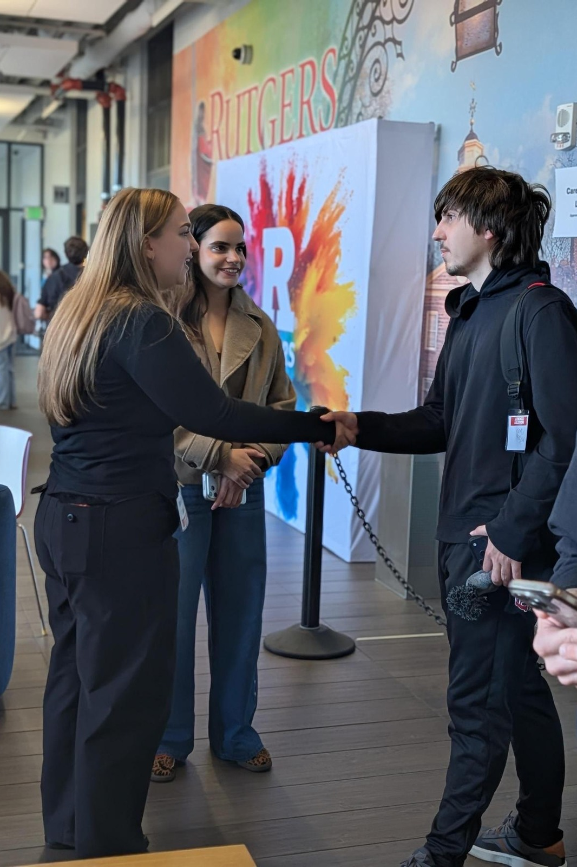

PURSUE YOUR POST-GRADUATE GOALS
Build Relationships
and Practice Networking
Introduce yourself. Listen. Follow through.
Notes:
LESSON: Build Relationships and Practice Networking
SLIDE 1 OF 17
FACILITATOR GUIDE
Learning objectives
Prepare a purposeful introduction and open questions for a contact.
Practice listening, follow-up questions, and a respectful close.
Use individual feedback to improve a second conversation.
Plan a primary, alternative, and adjacent route for making progress.
Preparation and materials
Read this guide and the linked resources before teaching. Rehearse the worked example. Print the Student planner and make the key terms and feedback checklist available. Prepare a timer, writing space, and A/B/C/D response method. Slides and paid tools are not required. Keep the instructor answer key separate from student materials.
Background for a first time facilitator
Read these terms before class. Introduce them with a short example rather than assuming students know the vocabulary. The teaching suggestions and fictional cases are instructional adaptations, not records of actual outcomes.
SOURCE GUIDE
/Users/wj85/.codex/outputs/career-readiness-lessons/complete-library/10-networking-facilitator-guide.docx
SOURCES
https://careers.rutgers.edu/news/pointers-authentic-networking
https://careers.rutgers.edu/Mentoring
https://careers.rutgers.edu/students-alumni/career-internship-guide
PHOTO
/Users/wj85/Library/CloudStorage/OneDrive-RutgersUniversity/0 - Shared Department Files/Department-wide/Communications and Marketing/Photo Library/2026-2027 Academic Year/Industry Connect - Arts, Media, and Communications/Media.jpeg
Photograph is illustrative. People shown are not the fictional case participants.
DELIVERY
Move directly to the opening student activity after a brief welcome. Full instructions, worksheets, and accessibility alternatives are in the matching facilitator guide. This deck uses CES branding only.

Slide 2
Something you want to learn
Tell a partner what you are curious about in a career field. Your partner asks one question that helps you get more specific.
Think or write first. Then compare with a partner.
Notes:
LESSON: Build Relationships and Practice Networking
SLIDE 2 OF 17
SESSION TIMING: 0–5 minutes
FACILITATOR GUIDE
0 to 5 minutes Opening challenge
Facilitator actions:
Read the prompt below. Give one minute to think, two minutes for partners to try it, and two minutes to hear two observations. Start with participation before explaining the framework.
Say to students:
“In pairs, introduce yourself and ask a question you would use with an alumnus or professional. Try for 30 seconds each. Write one thing that felt natural and one thing you want to improve.”
Ask students:
“What did you notice, and what would help you improve your next attempt?”
Expected responses:
A specific observation about the task, a choice, or a gap in information.
If students need support:
For a memorized monologue, ask the student to stop after one question and paraphrase the answer. For “I know nobody,” identify a faculty, staff, peer, or alumni starting point. Assess preparation and responsiveness rather than extroversion, accent, or number of contacts.
Transition to the next activity:
“Let us add language and a method that can help with the next attempt.”
SOURCE GUIDE
/Users/wj85/.codex/outputs/career-readiness-lessons/complete-library/10-networking-facilitator-guide.docx
SOURCES
https://careers.rutgers.edu/news/pointers-authentic-networking
https://careers.rutgers.edu/Mentoring
https://careers.rutgers.edu/students-alumni/career-internship-guide

Slide 3
A networking conversation
01
02
03
INTRODUCE
ASK AND LISTEN
CLOSE AND FOLLOW UP
Share relevant context and what you hope to learn.
Use an open question. Follow up on the response.
Thank the person and agree on an appropriate next step.
03
Notes:
LESSON: Build Relationships and Practice Networking
SLIDE 3 OF 17
SESSION TIMING: 5–12 minutes
FACILITATOR GUIDE
Background for a first time facilitator
Read these terms before class. Introduce them with a short example rather than assuming students know the vocabulary. The teaching suggestions and fictional cases are instructional adaptations, not records of actual outcomes.
A short explanation you can use
Say to students:
“Networking is a conversation, not a request for someone to solve your search. Prepare a purpose and questions, listen to the answer, and ask a follow-up based on what you heard. You can start with faculty, staff, classmates, alumni, or other existing connections. A clear close and follow-through help sustain a relationship.”
Key terms:
Networking: Building and maintaining relationships through exchange and learning.
Introduction: A short explanation of who you are, your interest, and why you are connecting.
Open question: A question that invites explanation rather than only yes or no.
Follow-through: A specific next action, such as a thank-you message referencing the conversation.
Adjacent route: A related opportunity that uses similar interests or skills when the original route is unavailable.
SOURCE GUIDE
/Users/wj85/.codex/outputs/career-readiness-lessons/complete-library/10-networking-facilitator-guide.docx
SOURCES
https://careers.rutgers.edu/news/pointers-authentic-networking
https://careers.rutgers.edu/Mentoring
https://careers.rutgers.edu/students-alumni/career-internship-guide

Slide 4
An introduction with a purpose
01
02
03
WHO YOU ARE
WHAT YOU ARE EXPLORING
WHAT YOU HOPE TO LEARN
A concise piece of relevant context
A question or interest connected to this conversation
A specific request for insight, not an assumed referral
04
Notes:
LESSON: Build Relationships and Practice Networking
SLIDE 4 OF 17
SESSION TIMING: 5–12 minutes
FACILITATOR GUIDE
Background for a first time facilitator
Read these terms before class. Introduce them with a short example rather than assuming students know the vocabulary. The teaching suggestions and fictional cases are instructional adaptations, not records of actual outcomes.
A short explanation you can use
Say to students:
“Networking is a conversation, not a request for someone to solve your search. Prepare a purpose and questions, listen to the answer, and ask a follow-up based on what you heard. You can start with faculty, staff, classmates, alumni, or other existing connections. A clear close and follow-through help sustain a relationship.”
Key terms:
Networking: Building and maintaining relationships through exchange and learning.
Introduction: A short explanation of who you are, your interest, and why you are connecting.
Open question: A question that invites explanation rather than only yes or no.
Follow-through: A specific next action, such as a thank-you message referencing the conversation.
Adjacent route: A related opportunity that uses similar interests or skills when the original route is unavailable.
SOURCE GUIDE
/Users/wj85/.codex/outputs/career-readiness-lessons/complete-library/10-networking-facilitator-guide.docx
SOURCES
https://careers.rutgers.edu/news/pointers-authentic-networking
https://careers.rutgers.edu/Mentoring
https://careers.rutgers.edu/students-alumni/career-internship-guide

Slide 5
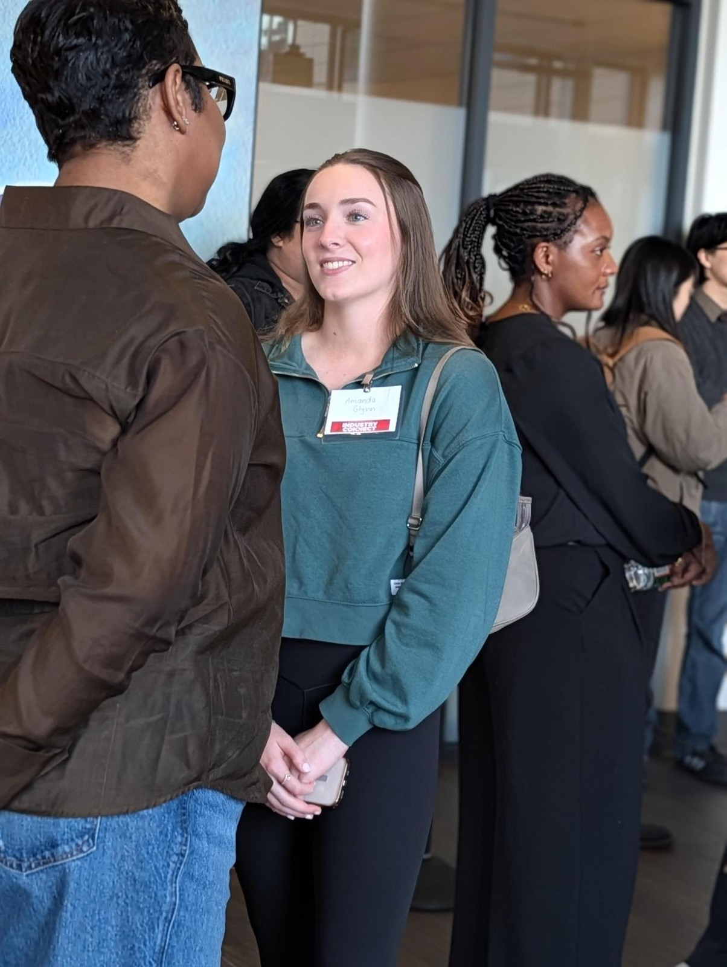
A fictional case
THE APPROACH
Taylor asks an unfamiliar alum for an internship and interrupts the response.
WHAT IS MISSING
A clear learning purpose and questions about the alum’s experience
THE REVISION
A concise introduction, an open question, and a respectful close
05
Notes:
LESSON: Build Relationships and Practice Networking
SLIDE 5 OF 17
SESSION TIMING: 12–20 minutes
FACILITATOR GUIDE
12 to 20 minutes Shared case
Read aloud:
Taylor approaches an alumnus and says, “I need an internship. Can you get me one?” The alumnus describes their field, but Taylor interrupts with a memorized pitch and asks no questions. Taylor leaves without a next step.
Facilitator actions:
Give pairs three minutes to identify a gap and recommend a change. Use three minutes to hear two recommendations and explain the answer guidance. Spend the final two minutes modeling a revised response or the worked example.
Ask students:
“What is missing? What evidence or information would help? What would you change first?”
Answer guidance:
Replace the immediate job demand with a learning purpose, a brief introduction, and a specific open question. Listen before adding a follow-up. Ask whether a later question or suggested resource would be appropriate. Sending a job request or adding contacts without a conversation is not the same as building a relationship.
Original case:
Taylor approaches an alumnus and says, “I need an internship. Can you get me one?” The alumnus describes their field, but Taylor interrupts with a memorized pitch and asks no questions. Taylor leaves without a next step.
Allow pair discussion before showing the next slide.
SOURCE GUIDE
/Users/wj85/.codex/outputs/career-readiness-lessons/complete-library/10-networking-facilitator-guide.docx
SOURCES
https://careers.rutgers.edu/news/pointers-authentic-networking
https://careers.rutgers.edu/Mentoring
https://careers.rutgers.edu/students-alumni/career-internship-guide
PHOTO
/Users/wj85/Library/CloudStorage/OneDrive-RutgersUniversity/0 - Shared Department Files/Department-wide/Communications and Marketing/Photo Library/2026-2027 Academic Year/Industry Connect - Arts, Media, and Communications/Media (10).jpeg
Photograph is illustrative. People shown are not the fictional case participants.

Slide 6
Case discussion
01
02
03
A SPECIFIC PURPOSE
A REAL CONVERSATION
A FEASIBLE NEXT STEP
What do you want to understand?
Listen and ask a follow-up question.
Thank the person and follow through appropriately.
06
Notes:
LESSON: Build Relationships and Practice Networking
SLIDE 6 OF 17
SESSION TIMING: 12–20 minutes
FACILITATOR GUIDE
Replace the immediate job demand with a learning purpose, a brief introduction, and a specific open question. Listen before adding a follow-up. Ask whether a later question or suggested resource would be appropriate. Sending a job request or adding contacts without a conversation is not the same as building a relationship.
12 to 20 minutes Shared case
Read aloud:
Taylor approaches an alumnus and says, “I need an internship. Can you get me one?” The alumnus describes their field, but Taylor interrupts with a memorized pitch and asks no questions. Taylor leaves without a next step.
Facilitator actions:
Give pairs three minutes to identify a gap and recommend a change. Use three minutes to hear two recommendations and explain the answer guidance. Spend the final two minutes modeling a revised response or the worked example.
Ask students:
“What is missing? What evidence or information would help? What would you change first?”
Answer guidance:
Replace the immediate job demand with a learning purpose, a brief introduction, and a specific open question. Listen before adding a follow-up. Ask whether a later question or suggested resource would be appropriate. Sending a job request or adding contacts without a conversation is not the same as building a relationship.
SOURCE GUIDE
/Users/wj85/.codex/outputs/career-readiness-lessons/complete-library/10-networking-facilitator-guide.docx
SOURCES
https://careers.rutgers.edu/news/pointers-authentic-networking
https://careers.rutgers.edu/Mentoring
https://careers.rutgers.edu/students-alumni/career-internship-guide

Slide 7
Your student planner
01
02
03
PREPARE
ASK
PLAN
Choose a contact or fictional role. Draft a short introduction.
Write three open questions and practice a follow-up.
Draft a thank-you. Identify another contact, channel, or adjacent field.
Use the matching Student planner in the facilitator guide.
07
Notes:
LESSON: Build Relationships and Practice Networking
SLIDE 7 OF 17
SESSION TIMING: 20–35 minutes
FACILITATOR GUIDE
20 to 35 minutes Main activity
Facilitator actions:
Use the Networking planner. Spend four minutes choosing a contact and purpose, four drafting an introduction and three questions, four drafting outreach and follow-through, and three mapping alternative routes. For an event, identify the person or organization to research beforehand. No real message is sent as a class requirement.
Say to students:
“Create a first draft using the planner. Mark anything you do not know instead of inventing a fact. You will receive feedback and revise.”
Coaching guidance:
For a memorized monologue, ask the student to stop after one question and paraphrase the answer. For “I know nobody,” identify a faculty, staff, peer, or alumni starting point. Assess preparation and responsiveness rather than extroversion, accent, or number of contacts.
Transition to the next activity:
“Choose the part of your draft you most want a listener to test.”
WORKSHEET PROMPTS
Contact or type of contact and a learning purpose. What can I learn, and what shared interest can I bring?
Draft a 30-second introduction and three open questions. Leave room for an unscripted follow-up.
Draft a concise outreach request and a thank-you message that references a possible conversation detail.
Plan A contact, Plan B contact or channel, and an adjacent field or event. What will I change if there is no response or hiring conditions shift?
Choose an action within seven days and a date to reassess. How could this first conversation support later directions?
SOURCE GUIDE
/Users/wj85/.codex/outputs/career-readiness-lessons/complete-library/10-networking-facilitator-guide.docx
SOURCES
https://careers.rutgers.edu/news/pointers-authentic-networking
https://careers.rutgers.edu/Mentoring
https://careers.rutgers.edu/students-alumni/career-internship-guide

Slide 8
A worked response
I am a Rutgers student interested in how organizations use analysis to improve services. Your work with community programs caught my attention. What does a typical project involve, and what preparation has helped you most? After listening: You mentioned working across teams—what helps those teams make decisions together? Thank you; may I follow up after I explore the resource you suggested?
What makes the response specific? What would you adapt?
08
Notes:
LESSON: Build Relationships and Practice Networking
SLIDE 8 OF 17
SESSION TIMING: 20–35 minutes
FACILITATOR GUIDE
A worked response
I am a Rutgers student interested in how organizations use analysis to improve services. Your work with community programs caught my attention. What does a typical project involve, and what preparation has helped you most? After listening: You mentioned working across teams—what helps those teams make decisions together? Thank you; may I follow up after I explore the resource you suggested?
I am a Rutgers student interested in how organizations use analysis to improve services. Your work with community programs caught my attention. What does a typical project involve, and what preparation has helped you most? After listening: You mentioned working across teams—what helps those teams make decisions together? Thank you; may I follow up after I explore the resource you suggested?
SOURCE GUIDE
/Users/wj85/.codex/outputs/career-readiness-lessons/complete-library/10-networking-facilitator-guide.docx
SOURCES
https://careers.rutgers.edu/news/pointers-authentic-networking
https://careers.rutgers.edu/Mentoring
https://careers.rutgers.edu/students-alumni/career-internship-guide

Slide 9
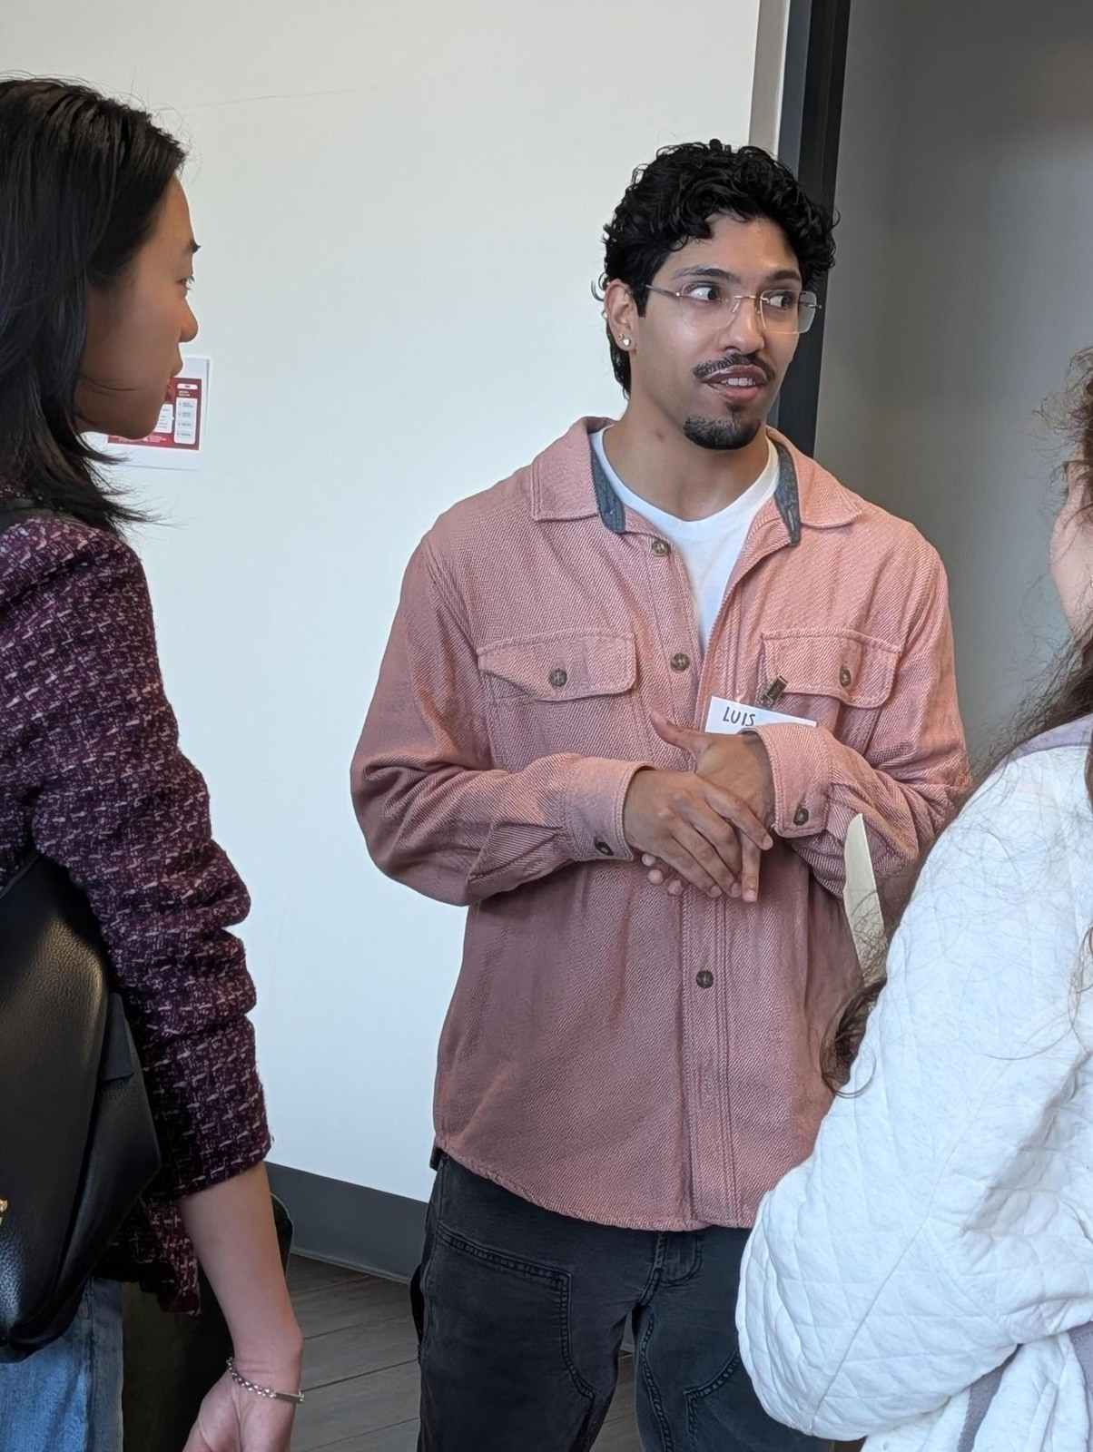
Feedback and revision
WHAT IS CLEAR
Name one specific detail that supports the response.
WHAT NEEDS WORK
Identify one missing piece or unsupported assumption.
WHAT CHANGES
Agree on one revision, then try again.
09
Notes:
LESSON: Build Relationships and Practice Networking
SLIDE 9 OF 17
SESSION TIMING: 35–50 minutes
FACILITATOR GUIDE
35 to 50 minutes Individual feedback and revision
Facilitator actions:
35–39: Partner A explains or role-plays the draft for two minutes; Partner B gives two minutes of specific feedback using the checklist below. 39–43: Swap. 43–46: Both revise. 46–50: Each gives a two-minute revised attempt. Use the role instructions below for the listener.
Say to students:
“Identify one detail that works, one question you still have, and one change the speaker can make. Respond to the actual draft, then listen for the change in the second attempt.”
Listener role: Act as the professional contact, interviewer, or employer in the conversation. Answer naturally and offer feedback on the attempt.
Feedback sentence: “The detail ___ helped because ___. I still need to understand ___. Try changing ___.”
Review checks:
Is the purpose clear and the request manageable?
Does the speaker listen and ask a genuine follow-up?
Does the close respect the other person’s time?
Does follow-through use a conversation detail and include an alternative route?
Coaching:
For a memorized monologue, ask the student to stop after one question and paraphrase the answer. For “I know nobody,” identify a faculty, staff, peer, or alumni starting point. Assess preparation and responsiveness rather than extroversion, accent, or number of contacts.
SOURCE GUIDE
/Users/wj85/.codex/outputs/career-readiness-lessons/complete-library/10-networking-facilitator-guide.docx
SOURCES
https://careers.rutgers.edu/news/pointers-authentic-networking
https://careers.rutgers.edu/Mentoring
https://careers.rutgers.edu/students-alumni/career-internship-guide
PHOTO
/Users/wj85/Library/CloudStorage/OneDrive-RutgersUniversity/0 - Shared Department Files/Department-wide/Communications and Marketing/Photo Library/2026-2027 Academic Year/Industry Connect - Arts, Media, and Communications/Media (3).jpeg
Photograph is illustrative. People shown are not the fictional case participants.

Slide 10
Both partners get a second attempt
01
02
03
ROUND ONE
SWAP ROLES
REVISE AND RETRY
Partner A explains or role-plays. Partner B gives specific feedback.
Partner B explains or role-plays. Partner A gives feedback.
Both apply one suggestion and repeat the key response.
10
Notes:
LESSON: Build Relationships and Practice Networking
SLIDE 10 OF 17
SESSION TIMING: 35–50 minutes
FACILITATOR GUIDE
35 to 50 minutes Individual feedback and revision
Facilitator actions:
35–39: Partner A explains or role-plays the draft for two minutes; Partner B gives two minutes of specific feedback using the checklist below. 39–43: Swap. 43–46: Both revise. 46–50: Each gives a two-minute revised attempt. Use the role instructions below for the listener.
Say to students:
“Identify one detail that works, one question you still have, and one change the speaker can make. Respond to the actual draft, then listen for the change in the second attempt.”
Listener role: Act as the professional contact, interviewer, or employer in the conversation. Answer naturally and offer feedback on the attempt.
Feedback sentence: “The detail ___ helped because ___. I still need to understand ___. Try changing ___.”
Use the role and deliverable specified in the guide. A written exchange, recorded response, or private practice can provide an equivalent feedback-and-revision cycle.
SOURCE GUIDE
/Users/wj85/.codex/outputs/career-readiness-lessons/complete-library/10-networking-facilitator-guide.docx
SOURCES
https://careers.rutgers.edu/news/pointers-authentic-networking
https://careers.rutgers.edu/Mentoring
https://careers.rutgers.edu/students-alumni/career-internship-guide

Slide 11
Knowledge check 1
Which opening best supports a relationship?
A
Get me a job
B
Here is my whole resume aloud
C
A short introduction and a question about their work
D
Tell me nothing unless you are hiring
11
Notes:
LESSON: Build Relationships and Practice Networking
SLIDE 11 OF 17
SESSION TIMING: Closing reinforcement
FACILITATOR GUIDE
50 to 58 minutes Closing challenge
Use four quiz questions from the instructor key: allow about 30 seconds to choose and 30 seconds to explain each answer, four minutes total. Then use four minutes for an adaptation challenge: two minutes to write a change and two minutes to compare with a partner.
Adaptation prompt:
“Your preferred opportunity is paused or its requirements change. Use your Plan B or adjacent route to choose a next action while preserving what matters to you. Explain how a first destination could support later movement.”
INSTRUCTOR ANSWER KEY
Correct answer: C. A short introduction and a question about their work
Explanation: A purpose and open question invite conversation.
Accept A/B/C/D cards, fingers, chat, polling, or a Kahoot created from these items. Ask for a rationale before giving feedback. Answers are in notes only.
SOURCE GUIDE
/Users/wj85/.codex/outputs/career-readiness-lessons/complete-library/10-networking-facilitator-guide.docx
SOURCES
https://careers.rutgers.edu/news/pointers-authentic-networking
https://careers.rutgers.edu/Mentoring
https://careers.rutgers.edu/students-alumni/career-internship-guide

Slide 12
Knowledge check 2
What is active listening in this setting?
A
Asking a follow-up connected to the answer
B
Waiting to repeat your pitch
C
Interrupting with unrelated facts
D
Collecting contact details only
12
Notes:
LESSON: Build Relationships and Practice Networking
SLIDE 12 OF 17
SESSION TIMING: Closing reinforcement
FACILITATOR GUIDE
50 to 58 minutes Closing challenge
Use four quiz questions from the instructor key: allow about 30 seconds to choose and 30 seconds to explain each answer, four minutes total. Then use four minutes for an adaptation challenge: two minutes to write a change and two minutes to compare with a partner.
Adaptation prompt:
“Your preferred opportunity is paused or its requirements change. Use your Plan B or adjacent route to choose a next action while preserving what matters to you. Explain how a first destination could support later movement.”
INSTRUCTOR ANSWER KEY
Correct answer: A. Asking a follow-up connected to the answer
Explanation: The follow-up shows attention to what was said.
Accept A/B/C/D cards, fingers, chat, polling, or a Kahoot created from these items. Ask for a rationale before giving feedback. Answers are in notes only.
SOURCE GUIDE
/Users/wj85/.codex/outputs/career-readiness-lessons/complete-library/10-networking-facilitator-guide.docx
SOURCES
https://careers.rutgers.edu/news/pointers-authentic-networking
https://careers.rutgers.edu/Mentoring
https://careers.rutgers.edu/students-alumni/career-internship-guide

Slide 13
Knowledge check 3
What is useful feedback?
A
Be more impressive
B
Your purpose was clear; ask a follow-up about the task they mentioned
C
Talk as fast as possible
D
Use more titles
13
Notes:
LESSON: Build Relationships and Practice Networking
SLIDE 13 OF 17
SESSION TIMING: Closing reinforcement
FACILITATOR GUIDE
50 to 58 minutes Closing challenge
Use four quiz questions from the instructor key: allow about 30 seconds to choose and 30 seconds to explain each answer, four minutes total. Then use four minutes for an adaptation challenge: two minutes to write a change and two minutes to compare with a partner.
Adaptation prompt:
“Your preferred opportunity is paused or its requirements change. Use your Plan B or adjacent route to choose a next action while preserving what matters to you. Explain how a first destination could support later movement.”
INSTRUCTOR ANSWER KEY
Correct answer: B. Your purpose was clear; ask a follow-up about the task they mentioned
Explanation: Specific feedback gives the speaker something to change.
Accept A/B/C/D cards, fingers, chat, polling, or a Kahoot created from these items. Ask for a rationale before giving feedback. Answers are in notes only.
SOURCE GUIDE
/Users/wj85/.codex/outputs/career-readiness-lessons/complete-library/10-networking-facilitator-guide.docx
SOURCES
https://careers.rutgers.edu/news/pointers-authentic-networking
https://careers.rutgers.edu/Mentoring
https://careers.rutgers.edu/students-alumni/career-internship-guide

Slide 14
Knowledge check 4
If a contact does not respond, what helps?
A
Assume the career is closed
B
Send repeated demands
C
Invent a referral
D
Use a respectful alternative contact or channel and reassess
14
Notes:
LESSON: Build Relationships and Practice Networking
SLIDE 14 OF 17
SESSION TIMING: Closing reinforcement
FACILITATOR GUIDE
50 to 58 minutes Closing challenge
Use four quiz questions from the instructor key: allow about 30 seconds to choose and 30 seconds to explain each answer, four minutes total. Then use four minutes for an adaptation challenge: two minutes to write a change and two minutes to compare with a partner.
Adaptation prompt:
“Your preferred opportunity is paused or its requirements change. Use your Plan B or adjacent route to choose a next action while preserving what matters to you. Explain how a first destination could support later movement.”
INSTRUCTOR ANSWER KEY
Correct answer: D. Use a respectful alternative contact or channel and reassess
Explanation: Multiple routes support progress without depending on one contact.
Accept A/B/C/D cards, fingers, chat, polling, or a Kahoot created from these items. Ask for a rationale before giving feedback. Answers are in notes only.
SOURCE GUIDE
/Users/wj85/.codex/outputs/career-readiness-lessons/complete-library/10-networking-facilitator-guide.docx
SOURCES
https://careers.rutgers.edu/news/pointers-authentic-networking
https://careers.rutgers.edu/Mentoring
https://careers.rutgers.edu/students-alumni/career-internship-guide

Slide 15
An adaptation challenge
Your intended contact cannot meet. What other person or channel could help you learn about the same question?
Explain what you would change and why. Then revise your plan.
Notes:
LESSON: Build Relationships and Practice Networking
SLIDE 15 OF 17
SESSION TIMING: 54–58 minutes
FACILITATOR GUIDE
50 to 58 minutes Closing challenge
Use four quiz questions from the instructor key: allow about 30 seconds to choose and 30 seconds to explain each answer, four minutes total. Then use four minutes for an adaptation challenge: two minutes to write a change and two minutes to compare with a partner.
Adaptation prompt:
“Your preferred opportunity is paused or its requirements change. Use your Plan B or adjacent route to choose a next action while preserving what matters to you. Explain how a first destination could support later movement.”
SOURCE GUIDE
/Users/wj85/.codex/outputs/career-readiness-lessons/complete-library/10-networking-facilitator-guide.docx
SOURCES
https://careers.rutgers.edu/news/pointers-authentic-networking
https://careers.rutgers.edu/Mentoring
https://careers.rutgers.edu/students-alumni/career-internship-guide

Slide 16
Your next step
Your revision
What improved after feedback?
Your action
What specific step will you take?
Your check
When will you review it, and what will you look for?
16
Notes:
LESSON: Build Relationships and Practice Networking
SLIDE 16 OF 17
SESSION TIMING: 58–60 minutes
FACILITATOR GUIDE
58 to 60 minutes Exit commitment
Collect the revised planner, one change made after feedback, and a specific next step with a date. Ask students to name a resource or person they will consult. Close with: “Use what you learned today, check what you still do not know, and revisit the plan after you act.”
SOURCE GUIDE
/Users/wj85/.codex/outputs/career-readiness-lessons/complete-library/10-networking-facilitator-guide.docx
SOURCES
https://careers.rutgers.edu/news/pointers-authentic-networking
https://careers.rutgers.edu/Mentoring
https://careers.rutgers.edu/students-alumni/career-internship-guide

Slide 17
Resources for your next step
01
CES authentic networking
careers.rutgers.edu/news/pointers-authentic-networking
02
Scarlet Career Mentoring Network
careers.rutgers.edu/Mentoring
03
CES Guide
careers.rutgers.edu/students-alumni/career-internship-guide
17
Notes:
LESSON: Build Relationships and Practice Networking
SLIDE 17 OF 17
SESSION TIMING: After the closing commitment
FACILITATOR GUIDE
Resources and follow through
After class, ask students to take their dated step and briefly report what they learned. Use the following resources as starting points; tools, dates, and eligibility should be checked before each delivery. Program and employer instructions control actual requirements.
CES authentic networking: https://careers.rutgers.edu/news/pointers-authentic-networking
Scarlet Career Mentoring Network: https://careers.rutgers.edu/Mentoring
CES Guide: https://careers.rutgers.edu/students-alumni/career-internship-guide
Framework reference: Building a Career-Ready Campus taskforce criteria supplied by the user. CES Career Journey descriptions reflect the user’s explanation. Resources checked November 1, 2026. Activities and examples are teaching adaptations.
SOURCE GUIDE
/Users/wj85/.codex/outputs/career-readiness-lessons/complete-library/10-networking-facilitator-guide.docx
SOURCES
https://careers.rutgers.edu/news/pointers-authentic-networking
https://careers.rutgers.edu/Mentoring
https://careers.rutgers.edu/students-alumni/career-internship-guide

