Slide 1


DISCOVER YOURSELF
Discover Yourself
Find patterns. Test possibilities.
Notes:
LESSON: Discover Yourself
SLIDE 1 OF 17
FACILITATOR GUIDE
Learning objectives
Identify interests, strengths, values, skills, motivations, and preferences using personal examples.
Explain how a transferable skill can appear in different settings.
Interpret patterns without treating an assessment or preference as a fixed career prescription.
Choose a small exploration action and a date to reflect again.
Preparation and materials
Read this guide and the linked resources before teaching. Rehearse the worked example. Print the Student planner and make the key terms and feedback checklist available. Prepare a timer, writing space, and A/B/C/D response method. Slides and paid tools are not required. Keep the instructor answer key separate from student materials.
Background for a first time facilitator
Read these terms before class. Introduce them with a short example rather than assuming students know the vocabulary. The teaching suggestions and fictional cases are instructional adaptations, not records of actual outcomes.
SOURCE GUIDE
/Users/wj85/.codex/outputs/career-readiness-lessons/complete-library/08-discover-yourself-facilitator-guide.docx
SOURCES
https://careers.rutgers.edu/discover-yourself
https://careers.rutgers.edu/students-and-alumni/onlinetools
https://careers.rutgers.edu/students-and-alumni
PHOTO
/Users/wj85/Library/CloudStorage/OneDrive-RutgersUniversity/0 - Shared Department Files/Department-wide/Communications and Marketing/Photo Library/Rutgers (R-Comm)/NR23RBS4610mh.JPG
Photograph is illustrative. People shown are not the fictional case participants.
DELIVERY
Move directly to the opening student activity after a brief welcome. Full instructions, worksheets, and accessibility alternatives are in the matching facilitator guide. This deck uses CES branding only.

Slide 2
A moment that stayed with you
Recall a moment when you felt absorbed, proud, or frustrated. What were you doing? What explains your reaction?
Think or write first. Then compare with a partner.
Notes:
LESSON: Discover Yourself
SLIDE 2 OF 17
SESSION TIMING: 0–5 minutes
FACILITATOR GUIDE
0 to 5 minutes Opening challenge
Facilitator actions:
Read the prompt below. Give one minute to think, two minutes for partners to try it, and two minutes to hear two observations. Start with participation before explaining the framework.
Say to students:
“Recall one moment this term when you felt absorbed, proud, or frustrated. Write what you were doing and one detail that explains your reaction. Share only what you choose.”
Ask students:
“What did you notice, and what would help you improve your next attempt?”
Expected responses:
A specific observation about the task, a choice, or a gap in information.
If students need support:
For “I have no skills,” ask about a task someone trusted them to do. For a single career verdict, ask what other possibilities could use the same interests or skills. Do not interpret psychological results or make assumptions about identity. Students can use a self-discovery inventory instead of a formal assessment.
Transition to the next activity:
“Let us add language and a method that can help with the next attempt.”
SOURCE GUIDE
/Users/wj85/.codex/outputs/career-readiness-lessons/complete-library/08-discover-yourself-facilitator-guide.docx
SOURCES
https://careers.rutgers.edu/discover-yourself
https://careers.rutgers.edu/students-and-alumni/onlinetools
https://careers.rutgers.edu/students-and-alumni

Slide 3
Your self-discovery evidence
01
02
03
INTERESTS AND SKILLS
VALUES AND MOTIVATIONS
PREFERENCES
What draws your attention? What can you do, and how do you know?
What matters to you? Why do you choose or persist in an activity?
Which settings or ways of working tend to suit you?
03
Notes:
LESSON: Discover Yourself
SLIDE 3 OF 17
SESSION TIMING: 5–12 minutes
FACILITATOR GUIDE
Background for a first time facilitator
Read these terms before class. Introduce them with a short example rather than assuming students know the vocabulary. The teaching suggestions and fictional cases are instructional adaptations, not records of actual outcomes.
A short explanation you can use
Say to students:
“We learn about ourselves by noticing patterns in what we do, what matters to us, and the feedback we receive. One moment can suggest a question; several examples help us test it. A self-discovery tool can start a conversation, but it does not select your career for you. Your identity and circumstances can shape what feels possible; you can investigate those influences without treating them as permanent limits.”
Key terms:
Interest: An activity or question that draws your attention.
Skill and strength: A skill is an ability you can develop; a strength is something you do well, supported by examples or feedback.
Value and motivation: A value is something that matters to you; motivation concerns why you choose or persist in an activity.
Preference: A setting or way of working you tend to favor. Preferences can change with experience.
Transferable skill: An ability usable in several settings. Explaining a class idea clearly may also help in work or service.
Interpretation: Making a tentative meaning from evidence and considering other explanations. It is not a diagnosis.
SOURCE GUIDE
/Users/wj85/.codex/outputs/career-readiness-lessons/complete-library/08-discover-yourself-facilitator-guide.docx
SOURCES
https://careers.rutgers.edu/discover-yourself
https://careers.rutgers.edu/students-and-alumni/onlinetools
https://careers.rutgers.edu/students-and-alumni

Slide 4
Interpretation stays open
01
02
03
EVIDENCE
INTERPRETATION
EXPERIMENT
A specific action, experience, or piece of feedback
A possible meaning that you can question
A small step to learn whether the interpretation fits
04
Notes:
LESSON: Discover Yourself
SLIDE 4 OF 17
SESSION TIMING: 5–12 minutes
FACILITATOR GUIDE
Background for a first time facilitator
Read these terms before class. Introduce them with a short example rather than assuming students know the vocabulary. The teaching suggestions and fictional cases are instructional adaptations, not records of actual outcomes.
A short explanation you can use
Say to students:
“We learn about ourselves by noticing patterns in what we do, what matters to us, and the feedback we receive. One moment can suggest a question; several examples help us test it. A self-discovery tool can start a conversation, but it does not select your career for you. Your identity and circumstances can shape what feels possible; you can investigate those influences without treating them as permanent limits.”
Key terms:
Interest: An activity or question that draws your attention.
Skill and strength: A skill is an ability you can develop; a strength is something you do well, supported by examples or feedback.
Value and motivation: A value is something that matters to you; motivation concerns why you choose or persist in an activity.
Preference: A setting or way of working you tend to favor. Preferences can change with experience.
Transferable skill: An ability usable in several settings. Explaining a class idea clearly may also help in work or service.
Interpretation: Making a tentative meaning from evidence and considering other explanations. It is not a diagnosis.
SOURCE GUIDE
/Users/wj85/.codex/outputs/career-readiness-lessons/complete-library/08-discover-yourself-facilitator-guide.docx
SOURCES
https://careers.rutgers.edu/discover-yourself
https://careers.rutgers.edu/students-and-alumni/onlinetools
https://careers.rutgers.edu/students-and-alumni

Slide 5
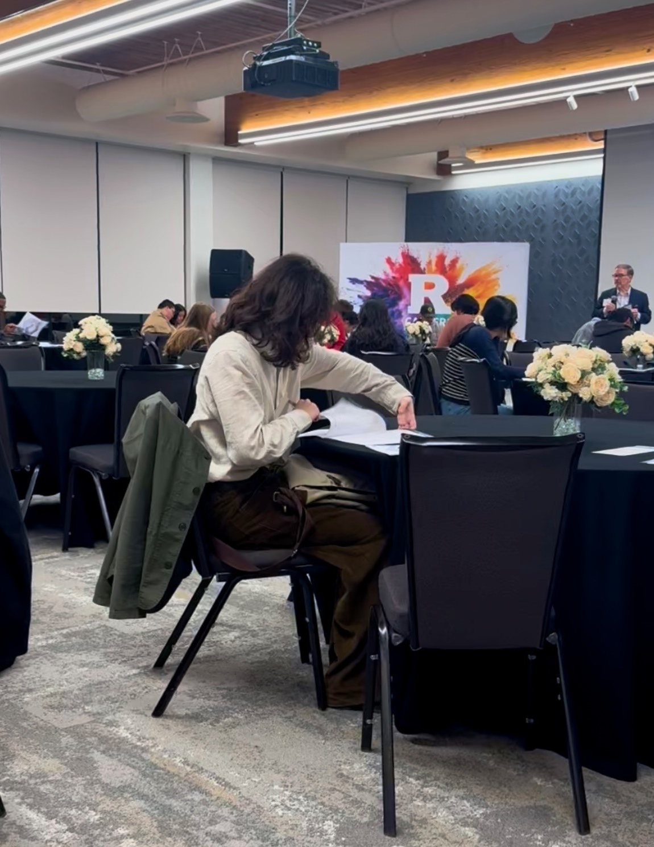
A fictional case
WHAT ALEX ENJOYED
Analyzing club attendance and explaining patterns
WHAT ALEX DISLIKED
A meeting where few people could speak
ALEX’S CONCLUSION
“I must be an analyst. I cannot work in groups.”
05
Notes:
LESSON: Discover Yourself
SLIDE 5 OF 17
SESSION TIMING: 12–20 minutes
FACILITATOR GUIDE
12 to 20 minutes Shared case
Read aloud:
Alex enjoyed analyzing club attendance, felt energized when explaining a pattern to others, and disliked a meeting in which only a few people could speak. Alex concludes: “I must become a data analyst, and I cannot work in groups.”
Facilitator actions:
Give pairs three minutes to identify a gap and recommend a change. Use three minutes to hear two recommendations and explain the answer guidance. Spend the final two minutes modeling a revised response or the worked example.
Ask students:
“What is missing? What evidence or information would help? What would you change first?”
Answer guidance:
Analysis may be an interest or skill; explaining patterns suggests communication; the meeting reaction may reflect a value of participation rather than a dislike of groups. Ask for more examples and feedback before drawing a broad conclusion. Data analysis is one possibility to investigate, not a conclusion established by the story.
Original case:
Alex enjoyed analyzing club attendance, felt energized when explaining a pattern to others, and disliked a meeting in which only a few people could speak. Alex concludes: “I must become a data analyst, and I cannot work in groups.”
Allow pair discussion before showing the next slide.
SOURCE GUIDE
/Users/wj85/.codex/outputs/career-readiness-lessons/complete-library/08-discover-yourself-facilitator-guide.docx
SOURCES
https://careers.rutgers.edu/discover-yourself
https://careers.rutgers.edu/students-and-alumni/onlinetools
https://careers.rutgers.edu/students-and-alumni
PHOTO
/Users/wj85/Library/CloudStorage/OneDrive-RutgersUniversity/0 - Shared Department Files/Department-wide/Communications and Marketing/Photo Library/2025-2026 Academic Year/Discover You_Signature Event/Discover You5.jpeg
Photograph is illustrative. People shown are not the fictional case participants.

Slide 6
Case discussion
01
02
03
A POSSIBLE INTEREST
A POSSIBLE VALUE
AN OPEN QUESTION
Analysis and explaining patterns
Participation and having a voice
Group work itself, or how that meeting worked?
06
Notes:
LESSON: Discover Yourself
SLIDE 6 OF 17
SESSION TIMING: 12–20 minutes
FACILITATOR GUIDE
Analysis may be an interest or skill; explaining patterns suggests communication; the meeting reaction may reflect a value of participation rather than a dislike of groups. Ask for more examples and feedback before drawing a broad conclusion. Data analysis is one possibility to investigate, not a conclusion established by the story.
12 to 20 minutes Shared case
Read aloud:
Alex enjoyed analyzing club attendance, felt energized when explaining a pattern to others, and disliked a meeting in which only a few people could speak. Alex concludes: “I must become a data analyst, and I cannot work in groups.”
Facilitator actions:
Give pairs three minutes to identify a gap and recommend a change. Use three minutes to hear two recommendations and explain the answer guidance. Spend the final two minutes modeling a revised response or the worked example.
Ask students:
“What is missing? What evidence or information would help? What would you change first?”
Answer guidance:
Analysis may be an interest or skill; explaining patterns suggests communication; the meeting reaction may reflect a value of participation rather than a dislike of groups. Ask for more examples and feedback before drawing a broad conclusion. Data analysis is one possibility to investigate, not a conclusion established by the story.
SOURCE GUIDE
/Users/wj85/.codex/outputs/career-readiness-lessons/complete-library/08-discover-yourself-facilitator-guide.docx
SOURCES
https://careers.rutgers.edu/discover-yourself
https://careers.rutgers.edu/students-and-alumni/onlinetools
https://careers.rutgers.edu/students-and-alumni

Slide 7
Your student planner
01
02
03
TWO MOMENTS
PATTERNS AND LIMITS
A SMALL EXPERIMENT
Record actions and evidence from different settings.
Consider skills, interests, values, and another explanation.
Name two directions, one uncertainty, and a review date.
Use the matching Student planner in the facilitator guide.
07
Notes:
LESSON: Discover Yourself
SLIDE 7 OF 17
SESSION TIMING: 20–35 minutes
FACILITATOR GUIDE
20 to 35 minutes Main activity
Facilitator actions:
Use the Self discovery evidence worksheet. Spend four minutes describing two different moments, four identifying possible patterns, three interpreting what those patterns suggest about identity or direction, and four identifying uncertainties and a small experiment. The opening moment can be one example. A student may use Alex’s case rather than disclose personal information.
Say to students:
“Create a first draft using the planner. Mark anything you do not know instead of inventing a fact. You will receive feedback and revise.”
Coaching guidance:
For “I have no skills,” ask about a task someone trusted them to do. For a single career verdict, ask what other possibilities could use the same interests or skills. Do not interpret psychological results or make assumptions about identity. Students can use a self-discovery inventory instead of a formal assessment.
Transition to the next activity:
“Choose the part of your draft you most want a listener to test.”
WORKSHEET PROMPTS
Describe two moments and your personal actions. What feedback or outcome supports each?
Name possible interests, strengths, skills, values, motivations, and preferences. Distinguish evidence from your interpretation.
Identify one transferable skill and a second setting where it could be useful.
How do identity, community, academic interests, or circumstances influence your interpretation? Share only what you choose.
Name two possible directions, one uncertainty, and an experiment to learn more. Set a date to revisit your interpretation.
SOURCE GUIDE
/Users/wj85/.codex/outputs/career-readiness-lessons/complete-library/08-discover-yourself-facilitator-guide.docx
SOURCES
https://careers.rutgers.edu/discover-yourself
https://careers.rutgers.edu/students-and-alumni/onlinetools
https://careers.rutgers.edu/students-and-alumni

Slide 8
A worked response
I enjoy finding patterns and explaining them, and I value participation. My club report and a class discussion provide examples. I will compare analytical and education-related roles and ask someone about the mix of independent and collaborative work. After that conversation, I will revisit whether my preference is about group work itself or how participation is organized.
What makes the response specific? What would you adapt?
08
Notes:
LESSON: Discover Yourself
SLIDE 8 OF 17
SESSION TIMING: 20–35 minutes
FACILITATOR GUIDE
A worked response
I enjoy finding patterns and explaining them, and I value participation. My club report and a class discussion provide examples. I will compare analytical and education-related roles and ask someone about the mix of independent and collaborative work. After that conversation, I will revisit whether my preference is about group work itself or how participation is organized.
I enjoy finding patterns and explaining them, and I value participation. My club report and a class discussion provide examples. I will compare analytical and education-related roles and ask someone about the mix of independent and collaborative work. After that conversation, I will revisit whether my preference is about group work itself or how participation is organized.
SOURCE GUIDE
/Users/wj85/.codex/outputs/career-readiness-lessons/complete-library/08-discover-yourself-facilitator-guide.docx
SOURCES
https://careers.rutgers.edu/discover-yourself
https://careers.rutgers.edu/students-and-alumni/onlinetools
https://careers.rutgers.edu/students-and-alumni

Slide 9
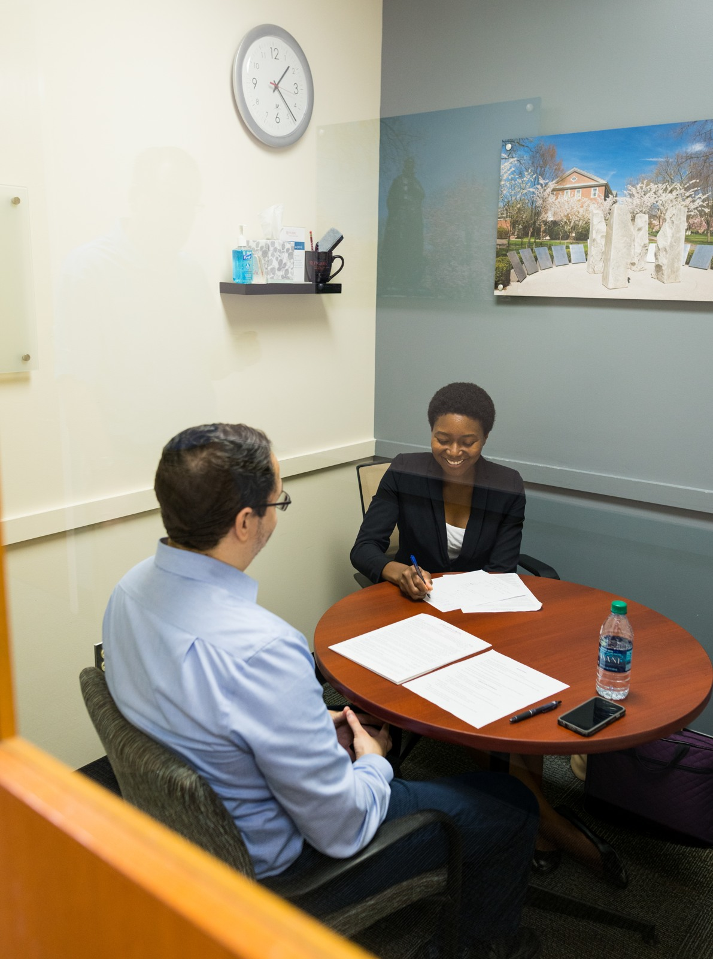
Feedback and revision
WHAT IS CLEAR
Name one specific detail that supports the response.
WHAT NEEDS WORK
Identify one missing piece or unsupported assumption.
WHAT CHANGES
Agree on one revision, then try again.
09
Notes:
LESSON: Discover Yourself
SLIDE 9 OF 17
SESSION TIMING: 35–50 minutes
FACILITATOR GUIDE
35 to 50 minutes Individual feedback and revision
Facilitator actions:
35–39: Partner A explains or role-plays the draft for two minutes; Partner B gives two minutes of specific feedback using the checklist below. 39–43: Swap. 43–46: Both revise. 46–50: Each gives a two-minute revised attempt. Use the role instructions below for the listener.
Say to students:
“Identify one detail that works, one question you still have, and one change the speaker can make. Respond to the actual draft, then listen for the change in the second attempt.”
Listener role: Act as a reviewer or advisor. Ask the speaker to explain their reasoning and point out information that needs clarification.
Feedback sentence: “The detail ___ helped because ___. I still need to understand ___. Try changing ___.”
Review checks:
Does the interpretation cite specific experience or feedback?
Are skills distinguished from interests, values, and preferences?
Does the student consider another explanation and avoid a fixed career verdict?
Is the next experiment feasible, with a date to revisit learning?
Coaching:
For “I have no skills,” ask about a task someone trusted them to do. For a single career verdict, ask what other possibilities could use the same interests or skills. Do not interpret psychological results or make assumptions about identity. Students can use a self-discovery inventory instead of a formal assessment.
SOURCE GUIDE
/Users/wj85/.codex/outputs/career-readiness-lessons/complete-library/08-discover-yourself-facilitator-guide.docx
SOURCES
https://careers.rutgers.edu/discover-yourself
https://careers.rutgers.edu/students-and-alumni/onlinetools
https://careers.rutgers.edu/students-and-alumni
PHOTO
/Users/wj85/Desktop/Dropbox/Rutgers Work/Marketing & Communications/Marketing Items/Photos/2017-2018 Acamdemic Year/Fall 2017/100917_Mock Interview Clinic/DSC04439.JPG
Photograph is illustrative. People shown are not the fictional case participants.

Slide 10
Both partners get a second attempt
01
02
03
ROUND ONE
SWAP ROLES
REVISE AND RETRY
Partner A explains or role-plays. Partner B gives specific feedback.
Partner B explains or role-plays. Partner A gives feedback.
Both apply one suggestion and repeat the key response.
10
Notes:
LESSON: Discover Yourself
SLIDE 10 OF 17
SESSION TIMING: 35–50 minutes
FACILITATOR GUIDE
35 to 50 minutes Individual feedback and revision
Facilitator actions:
35–39: Partner A explains or role-plays the draft for two minutes; Partner B gives two minutes of specific feedback using the checklist below. 39–43: Swap. 43–46: Both revise. 46–50: Each gives a two-minute revised attempt. Use the role instructions below for the listener.
Say to students:
“Identify one detail that works, one question you still have, and one change the speaker can make. Respond to the actual draft, then listen for the change in the second attempt.”
Listener role: Act as a reviewer or advisor. Ask the speaker to explain their reasoning and point out information that needs clarification.
Feedback sentence: “The detail ___ helped because ___. I still need to understand ___. Try changing ___.”
Use the role and deliverable specified in the guide. A written exchange, recorded response, or private practice can provide an equivalent feedback-and-revision cycle.
SOURCE GUIDE
/Users/wj85/.codex/outputs/career-readiness-lessons/complete-library/08-discover-yourself-facilitator-guide.docx
SOURCES
https://careers.rutgers.edu/discover-yourself
https://careers.rutgers.edu/students-and-alumni/onlinetools
https://careers.rutgers.edu/students-and-alumni

Slide 11
Knowledge check 1
A tool suggests a career. What is the strongest next step?
A
Treat it as a career assignment
B
Ignore all results
C
Compare it with experiences and investigate possibilities
D
Choose the highest salary only
11
Notes:
LESSON: Discover Yourself
SLIDE 11 OF 17
SESSION TIMING: Closing reinforcement
FACILITATOR GUIDE
50 to 58 minutes Closing challenge
Use four quiz questions from the instructor key: allow about 30 seconds to choose and 30 seconds to explain each answer, four minutes total. Then use four minutes for an adaptation challenge: two minutes to write a change and two minutes to compare with a partner.
Adaptation prompt:
“New experience gives you information that challenges your first interpretation. What would you revisit and how would you learn more?”
INSTRUCTOR ANSWER KEY
Correct answer: C. Compare it with experiences and investigate possibilities
Explanation: A result is a starting hypothesis to explore.
Accept A/B/C/D cards, fingers, chat, polling, or a Kahoot created from these items. Ask for a rationale before giving feedback. Answers are in notes only.
SOURCE GUIDE
/Users/wj85/.codex/outputs/career-readiness-lessons/complete-library/08-discover-yourself-facilitator-guide.docx
SOURCES
https://careers.rutgers.edu/discover-yourself
https://careers.rutgers.edu/students-and-alumni/onlinetools
https://careers.rutgers.edu/students-and-alumni

Slide 12
Knowledge check 2
Which is a transferable skill?
A
Listening carefully and clarifying a question
B
Membership in a club
C
A preferred work location
D
The title of a course
12
Notes:
LESSON: Discover Yourself
SLIDE 12 OF 17
SESSION TIMING: Closing reinforcement
FACILITATOR GUIDE
50 to 58 minutes Closing challenge
Use four quiz questions from the instructor key: allow about 30 seconds to choose and 30 seconds to explain each answer, four minutes total. Then use four minutes for an adaptation challenge: two minutes to write a change and two minutes to compare with a partner.
Adaptation prompt:
“New experience gives you information that challenges your first interpretation. What would you revisit and how would you learn more?”
INSTRUCTOR ANSWER KEY
Correct answer: A. Listening carefully and clarifying a question
Explanation: The action can be used in different settings.
Accept A/B/C/D cards, fingers, chat, polling, or a Kahoot created from these items. Ask for a rationale before giving feedback. Answers are in notes only.
SOURCE GUIDE
/Users/wj85/.codex/outputs/career-readiness-lessons/complete-library/08-discover-yourself-facilitator-guide.docx
SOURCES
https://careers.rutgers.edu/discover-yourself
https://careers.rutgers.edu/students-and-alumni/onlinetools
https://careers.rutgers.edu/students-and-alumni

Slide 13
Knowledge check 3
What strengthens an interpretation?
A
One label without examples
B
Several experiences and feedback, with alternative explanations
C
A friend choosing your career
D
Avoiding uncertainty
13
Notes:
LESSON: Discover Yourself
SLIDE 13 OF 17
SESSION TIMING: Closing reinforcement
FACILITATOR GUIDE
50 to 58 minutes Closing challenge
Use four quiz questions from the instructor key: allow about 30 seconds to choose and 30 seconds to explain each answer, four minutes total. Then use four minutes for an adaptation challenge: two minutes to write a change and two minutes to compare with a partner.
Adaptation prompt:
“New experience gives you information that challenges your first interpretation. What would you revisit and how would you learn more?”
INSTRUCTOR ANSWER KEY
Correct answer: B. Several experiences and feedback, with alternative explanations
Explanation: Patterns need evidence and room for revision.
Accept A/B/C/D cards, fingers, chat, polling, or a Kahoot created from these items. Ask for a rationale before giving feedback. Answers are in notes only.
SOURCE GUIDE
/Users/wj85/.codex/outputs/career-readiness-lessons/complete-library/08-discover-yourself-facilitator-guide.docx
SOURCES
https://careers.rutgers.edu/discover-yourself
https://careers.rutgers.edu/students-and-alumni/onlinetools
https://careers.rutgers.edu/students-and-alumni

Slide 14
Knowledge check 4
What should the closing plan include?
A
A promise never to change direction
B
A completed lifetime career plan
C
Only an assessment score
D
A small experiment and a date to revisit learning
14
Notes:
LESSON: Discover Yourself
SLIDE 14 OF 17
SESSION TIMING: Closing reinforcement
FACILITATOR GUIDE
50 to 58 minutes Closing challenge
Use four quiz questions from the instructor key: allow about 30 seconds to choose and 30 seconds to explain each answer, four minutes total. Then use four minutes for an adaptation challenge: two minutes to write a change and two minutes to compare with a partner.
Adaptation prompt:
“New experience gives you information that challenges your first interpretation. What would you revisit and how would you learn more?”
INSTRUCTOR ANSWER KEY
Correct answer: D. A small experiment and a date to revisit learning
Explanation: The plan supports continued exploration and growth.
Accept A/B/C/D cards, fingers, chat, polling, or a Kahoot created from these items. Ask for a rationale before giving feedback. Answers are in notes only.
SOURCE GUIDE
/Users/wj85/.codex/outputs/career-readiness-lessons/complete-library/08-discover-yourself-facilitator-guide.docx
SOURCES
https://careers.rutgers.edu/discover-yourself
https://careers.rutgers.edu/students-and-alumni/onlinetools
https://careers.rutgers.edu/students-and-alumni

Slide 15
An adaptation challenge
You receive feedback that challenges your interpretation. What would you investigate next?
Explain what you would change and why. Then revise your plan.
Notes:
LESSON: Discover Yourself
SLIDE 15 OF 17
SESSION TIMING: 54–58 minutes
FACILITATOR GUIDE
50 to 58 minutes Closing challenge
Use four quiz questions from the instructor key: allow about 30 seconds to choose and 30 seconds to explain each answer, four minutes total. Then use four minutes for an adaptation challenge: two minutes to write a change and two minutes to compare with a partner.
Adaptation prompt:
“New experience gives you information that challenges your first interpretation. What would you revisit and how would you learn more?”
SOURCE GUIDE
/Users/wj85/.codex/outputs/career-readiness-lessons/complete-library/08-discover-yourself-facilitator-guide.docx
SOURCES
https://careers.rutgers.edu/discover-yourself
https://careers.rutgers.edu/students-and-alumni/onlinetools
https://careers.rutgers.edu/students-and-alumni

Slide 16
Your next step
Your revision
What improved after feedback?
Your action
What specific step will you take?
Your check
When will you review it, and what will you look for?
16
Notes:
LESSON: Discover Yourself
SLIDE 16 OF 17
SESSION TIMING: 58–60 minutes
FACILITATOR GUIDE
58 to 60 minutes Exit commitment
Collect the revised planner, one change made after feedback, and a specific next step with a date. Ask students to name a resource or person they will consult. Close with: “Use what you learned today, check what you still do not know, and revisit the plan after you act.”
SOURCE GUIDE
/Users/wj85/.codex/outputs/career-readiness-lessons/complete-library/08-discover-yourself-facilitator-guide.docx
SOURCES
https://careers.rutgers.edu/discover-yourself
https://careers.rutgers.edu/students-and-alumni/onlinetools
https://careers.rutgers.edu/students-and-alumni

Slide 17
Resources for your next step
01
CES self-discovery resources
careers.rutgers.edu/discover-yourself
02
CES Online Tools including Traitify
careers.rutgers.edu/students-and-alumni/onlinetools
03
CES advising
careers.rutgers.edu/students-and-alumni
17
Notes:
LESSON: Discover Yourself
SLIDE 17 OF 17
SESSION TIMING: After the closing commitment
FACILITATOR GUIDE
Resources and follow through
After class, ask students to take their dated step and briefly report what they learned. Use the following resources as starting points; tools, dates, and eligibility should be checked before each delivery. Program and employer instructions control actual requirements.
CES self-discovery resources: https://careers.rutgers.edu/discover-yourself
CES Online Tools including Traitify: https://careers.rutgers.edu/students-and-alumni/onlinetools
CES advising: https://careers.rutgers.edu/students-and-alumni
Framework reference: Building a Career-Ready Campus taskforce criteria supplied by the user. CES Career Journey descriptions reflect the user’s explanation. Resources checked November 1, 2026. Activities and examples are teaching adaptations.
SOURCE GUIDE
/Users/wj85/.codex/outputs/career-readiness-lessons/complete-library/08-discover-yourself-facilitator-guide.docx
SOURCES
https://careers.rutgers.edu/discover-yourself
https://careers.rutgers.edu/students-and-alumni/onlinetools
https://careers.rutgers.edu/students-and-alumni

