Slide 1
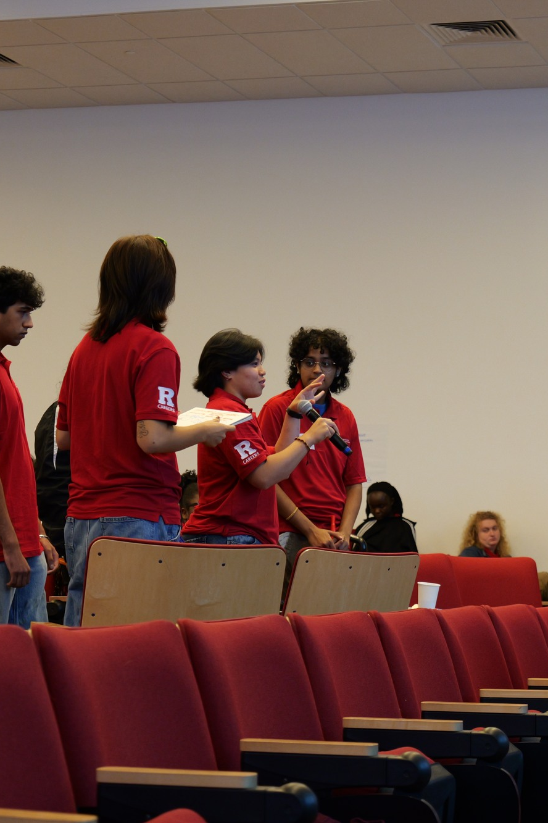

DEVELOP SKILLS AND COMPETENCIES
Career Readiness
Through Student Leadership
Reflect on your experience. Explain your contribution.
Notes:
LESSON: Career Readiness Through Student Leadership
SLIDE 1 OF 24
FACILITATOR GUIDE
How to use this guide
Read the teaching background and all suggested wording before the session. The preparation reading is outside the 60-minute student session. You may use the suggested language verbatim or adapt it after you understand the concept. Handouts and answer keys are included; slides are not needed to facilitate this version.
What you are teaching
NACE stands for the National Association of Colleges and Employers. Its career readiness competencies give students and educators a shared vocabulary for skills that can develop through learning and experience. CES connects academic and co-curricular learning with students’ future contributions. This lesson helps students recognize learning already occurring in their experience and practice explaining it.
Terminology for this lesson
Teach Equity & Inclusion as the NACE competency name, as requested for these materials. CES’s Becoming Career Ready article currently uses Fairness & Collaborative Learning, while Roadmap & Frameworks uses Equity & Inclusion. These pages use different labels; do not describe the CES alternative as NACE’s official name. NACE currently marks Equity & Inclusion as under review. The examples in this guide are teaching paraphrases, not verbatim definitions.
Preparation before the session
Read NACE’s official definitions and sample behaviors, then the teaching background. Practice the sample explanation aloud. Print the Student reflection worksheet and Practice explaining the experience handouts. Make the competency teaching table available. Test the quiz method and choose a way to collect the exit ticket. Read the case and its debrief before teaching. For large groups, keep partner work in place rather than waiting for every group to report.
SOURCE GUIDE
/Users/wj85/.codex/outputs/career-readiness-lessons/complete-library/03-nace-student-leadership-facilitator-guide.docx
SOURCES
Adapted from CES Presentation Library: 2025 CORE_Transferable Skills.pptx, slides 8–15; NACE & Suitable Overview 2026.pptx, slides 23–30.
Reflection and growth prompts informed by Professional Skills Self Reflection.pdf, pages 3–4, courtesy of Michele Baran, Life Design Solutions, LLC.
NACE competency framework: https://www.naceweb.org/career-readiness/competencies/career-readiness-defined
Fictional cases, audience-specific model responses, activities, timing, questions, and feedback checklist are newly developed adaptations. Models illustrate the case; they are not claims about actual Rutgers students.
https://www.naceweb.org/career-readiness/competencies/career-readiness-defined
PHOTO
/Users/wj85/Library/CloudStorage/OneDrive-RutgersUniversity/0 - Shared Department Files/Department-wide/Communications and Marketing/Photo Library/2026-2027 Academic Year/KIT Training/P1000051.JPG
Photograph is illustrative. People shown are not the fictional case participants.
DELIVERY
Move directly to the opening student activity after a brief welcome. Full instructions, worksheets, and accessibility alternatives are in the matching facilitator guide. This deck uses CES branding only.

Slide 2
One moment that mattered
Recall a time you helped a group get something done, with or without a formal title. Write one decision you made and who it affected.
1 minute to write. 2 minutes to share. A fictional example is welcome.
Notes:
LESSON: Career Readiness Through Student Leadership
SLIDE 2 OF 24
SESSION TIMING: 0–5 minutes
FACILITATOR GUIDE
Opening action from 0 to 5 minutes
Facilitator actions:
Begin the activity immediately. Allow one minute for individual thinking and writing, two minutes for partners, and two minutes to collect two or three action verbs on the board. Students can use the fictional case if they prefer.
Say to students:
“Recall a time you helped a group get something done, with or without a formal title. Write one decision you made and who it affected. We will return to that moment today. You do not need an impressive title or a perfect outcome. We are interested in what you did and what you learned.”
Ask students:
“What action did you hear your partner describe?”
Expected responses:
Concrete verbs such as asked, checked, compared, organized, listened, or revised.
If students need support:
If someone says “I learned a lot,” ask “What is one thing you did that helped you learn?” If nobody volunteers, offer “I checked a source before sharing it.”
Transition to the next activity:
“Those actions are where we can look for evidence of skills.”
SOURCE GUIDE
/Users/wj85/.codex/outputs/career-readiness-lessons/complete-library/03-nace-student-leadership-facilitator-guide.docx
SOURCES
Adapted from CES Presentation Library: 2025 CORE_Transferable Skills.pptx, slides 8–15; NACE & Suitable Overview 2026.pptx, slides 23–30.
Reflection and growth prompts informed by Professional Skills Self Reflection.pdf, pages 3–4, courtesy of Michele Baran, Life Design Solutions, LLC.
NACE competency framework: https://www.naceweb.org/career-readiness/competencies/career-readiness-defined
Fictional cases, audience-specific model responses, activities, timing, questions, and feedback checklist are newly developed adaptations. Models illustrate the case; they are not claims about actual Rutgers students.
https://www.naceweb.org/career-readiness/competencies/career-readiness-defined

Slide 3
Today’s work
01
02
03
REFLECT
CONNECT
EXPLAIN
Describe your actions and what you learned.
Match actions to competency behaviors.
Practice for an employer or graduate program.
03
Notes:
LESSON: Career Readiness Through Student Leadership
SLIDE 3 OF 24
SESSION TIMING: 5–12 minutes
FACILITATOR GUIDE
What you are teaching
NACE stands for the National Association of Colleges and Employers. Its career readiness competencies give students and educators a shared vocabulary for skills that can develop through learning and experience. CES connects academic and co-curricular learning with students’ future contributions. This lesson helps students recognize learning already occurring in their experience and practice explaining it.
Two distinctions to explain
Leadership helps shape the direction and conditions of shared work; Teamwork describes contributing and collaborating within it. One action may support both if the explanation is convincing. Technology means using tools thoughtfully and responsibly, not simply owning a device or naming software.
SOURCE GUIDE
/Users/wj85/.codex/outputs/career-readiness-lessons/complete-library/03-nace-student-leadership-facilitator-guide.docx
SOURCES
Adapted from CES Presentation Library: 2025 CORE_Transferable Skills.pptx, slides 8–15; NACE & Suitable Overview 2026.pptx, slides 23–30.
Reflection and growth prompts informed by Professional Skills Self Reflection.pdf, pages 3–4, courtesy of Michele Baran, Life Design Solutions, LLC.
NACE competency framework: https://www.naceweb.org/career-readiness/competencies/career-readiness-defined
Fictional cases, audience-specific model responses, activities, timing, questions, and feedback checklist are newly developed adaptations. Models illustrate the case; they are not claims about actual Rutgers students.
https://www.naceweb.org/career-readiness/competencies/career-readiness-defined

Slide 4




The NACE career readiness competencies
Career & Self-Development
Communication
Seek feedback and plan your growth.
Listen, clarify, and adapt your message.
Critical Thinking
Equity & Inclusion
Examine information and explain decisions.
Include perspectives and address barriers.
Teaching summaries. Examples depend on the actions and evidence.
04
Notes:
LESSON: Career Readiness Through Student Leadership
SLIDE 4 OF 24
SESSION TIMING: 5–12 minutes
FACILITATOR GUIDE
Terminology for this lesson
Teach Equity & Inclusion as the NACE competency name, as requested for these materials. CES’s Becoming Career Ready article currently uses Fairness & Collaborative Learning, while Roadmap & Frameworks uses Equity & Inclusion. These pages use different labels; do not describe the CES alternative as NACE’s official name. NACE currently marks Equity & Inclusion as under review. The examples in this guide are teaching paraphrases, not verbatim definitions.
Teaching the eight competencies
Use the explanations below during minutes 5–12. Read the meaning in your own words and give a short example. The examples are illustrative possibilities in this experience type; they are not claims that every student or the shared case demonstrates all eight.
Use NACE behaviors to evaluate evidence
Read NACE’s official definitions and sample behaviors before teaching: https://www.naceweb.org/career-readiness/competencies/career-readiness-defined. The summaries, examples, and coaching questions here are teaching adaptations. Use the official page as the reference when a connection is uncertain.
These are teaching summaries. Use the official NACE definitions and sample behaviors for fuller guidance. Equity & Inclusion is the name selected for these lessons. The CES Becoming Career Ready page uses Fairness & Collaborative Learning. NACE currently labels Equity & Inclusion under review. Source: https://www.naceweb.org/career-readiness/competencies/career-readiness-defined
SOURCE GUIDE
/Users/wj85/.codex/outputs/career-readiness-lessons/complete-library/03-nace-student-leadership-facilitator-guide.docx
SOURCES
Adapted from CES Presentation Library: 2025 CORE_Transferable Skills.pptx, slides 8–15; NACE & Suitable Overview 2026.pptx, slides 23–30.
Reflection and growth prompts informed by Professional Skills Self Reflection.pdf, pages 3–4, courtesy of Michele Baran, Life Design Solutions, LLC.
NACE competency framework: https://www.naceweb.org/career-readiness/competencies/career-readiness-defined
Fictional cases, audience-specific model responses, activities, timing, questions, and feedback checklist are newly developed adaptations. Models illustrate the case; they are not claims about actual Rutgers students.
https://www.naceweb.org/career-readiness/competencies/career-readiness-defined
Icons: NACE Competency Icon Set, CES Presentation Library; also published at https://careers.rutgers.edu/campus-partners/strategicplan-2030

Slide 5




The NACE career readiness competencies
Leadership
Professionalism
Use strengths toward a shared purpose.
Prepare, act responsibly, and follow through.
Teamwork
Technology
Share responsibility and work through differences.
Choose, learn, and use tools responsibly.
Teaching summaries. Examples depend on the actions and evidence.
05
Notes:
LESSON: Career Readiness Through Student Leadership
SLIDE 5 OF 24
SESSION TIMING: 5–12 minutes
FACILITATOR GUIDE
Terminology for this lesson
Teach Equity & Inclusion as the NACE competency name, as requested for these materials. CES’s Becoming Career Ready article currently uses Fairness & Collaborative Learning, while Roadmap & Frameworks uses Equity & Inclusion. These pages use different labels; do not describe the CES alternative as NACE’s official name. NACE currently marks Equity & Inclusion as under review. The examples in this guide are teaching paraphrases, not verbatim definitions.
Teaching the eight competencies
Use the explanations below during minutes 5–12. Read the meaning in your own words and give a short example. The examples are illustrative possibilities in this experience type; they are not claims that every student or the shared case demonstrates all eight.
Use NACE behaviors to evaluate evidence
Read NACE’s official definitions and sample behaviors before teaching: https://www.naceweb.org/career-readiness/competencies/career-readiness-defined. The summaries, examples, and coaching questions here are teaching adaptations. Use the official page as the reference when a connection is uncertain.
These are teaching summaries. Use the official NACE definitions and sample behaviors for fuller guidance. Equity & Inclusion is the name selected for these lessons. The CES Becoming Career Ready page uses Fairness & Collaborative Learning. NACE currently labels Equity & Inclusion under review. Source: https://www.naceweb.org/career-readiness/competencies/career-readiness-defined
SOURCE GUIDE
/Users/wj85/.codex/outputs/career-readiness-lessons/complete-library/03-nace-student-leadership-facilitator-guide.docx
SOURCES
Adapted from CES Presentation Library: 2025 CORE_Transferable Skills.pptx, slides 8–15; NACE & Suitable Overview 2026.pptx, slides 23–30.
Reflection and growth prompts informed by Professional Skills Self Reflection.pdf, pages 3–4, courtesy of Michele Baran, Life Design Solutions, LLC.
NACE competency framework: https://www.naceweb.org/career-readiness/competencies/career-readiness-defined
Fictional cases, audience-specific model responses, activities, timing, questions, and feedback checklist are newly developed adaptations. Models illustrate the case; they are not claims about actual Rutgers students.
https://www.naceweb.org/career-readiness/competencies/career-readiness-defined
Icons: NACE Competency Icon Set, CES Presentation Library; also published at https://careers.rutgers.edu/campus-partners/strategicplan-2030

Slide 6
A competency needs evidence
A LABEL
AN ACTION
“I am a strong communicator.”
“I checked that others understood.”
What did the person actually do?
A specific behavior gives the claim support.
06
Notes:
LESSON: Career Readiness Through Student Leadership
SLIDE 6 OF 24
SESSION TIMING: 5–12 minutes
FACILITATOR GUIDE
A simple example you can teach
“I am good at teamwork” is a claim. “I negotiated roles when two teammates had overlapping tasks, checked the revised plan with them, and completed my part” gives behavioral evidence. Ask what happened next to strengthen it further. Do not tell students they need an award, publication, or numerical improvement for their experience to count.
How to coach a connection
Ask the student to name an action, identify the relevant NACE behavior, and explain the connection. Check the match against NACE’s sample behaviors. Ask what outcome, feedback, or artifact supports it. A student can demonstrate more than one competency; choose the clearest evidence rather than requiring all eight. An experience title alone does not demonstrate the behavior.
SOURCE GUIDE
/Users/wj85/.codex/outputs/career-readiness-lessons/complete-library/03-nace-student-leadership-facilitator-guide.docx
SOURCES
Adapted from CES Presentation Library: 2025 CORE_Transferable Skills.pptx, slides 8–15; NACE & Suitable Overview 2026.pptx, slides 23–30.
Reflection and growth prompts informed by Professional Skills Self Reflection.pdf, pages 3–4, courtesy of Michele Baran, Life Design Solutions, LLC.
NACE competency framework: https://www.naceweb.org/career-readiness/competencies/career-readiness-defined
Fictional cases, audience-specific model responses, activities, timing, questions, and feedback checklist are newly developed adaptations. Models illustrate the case; they are not claims about actual Rutgers students.
https://www.naceweb.org/career-readiness/competencies/career-readiness-defined

Slide 7
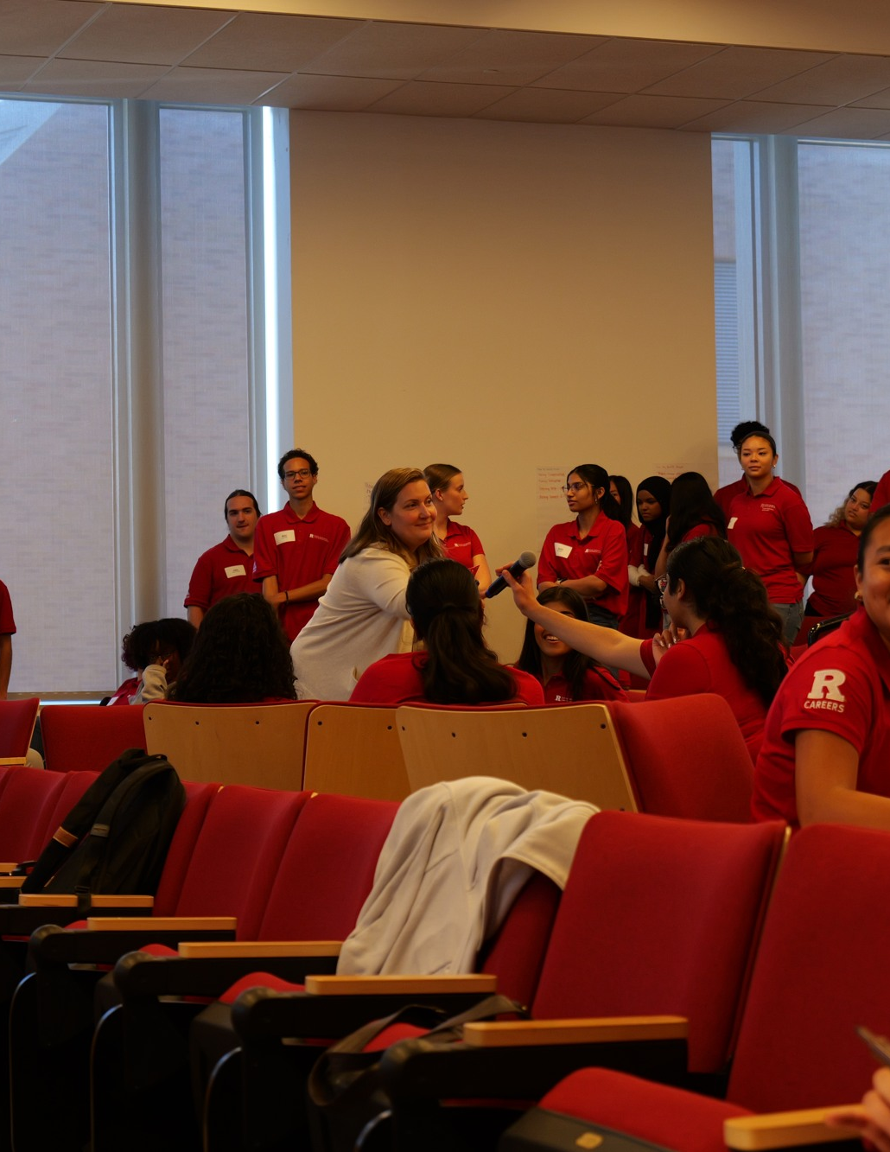
A fictional case
THE PROBLEM
Event registration and timing limit participation.
JORDAN’S ACTIONS
Jordan asks about barriers and coordinates changes with the committee.
THE OUTCOME
The team revises registration and adds another participation route.
07
Notes:
LESSON: Career Readiness Through Student Leadership
SLIDE 7 OF 24
SESSION TIMING: 12–20 minutes
FACILITATOR GUIDE
Teach the shared case from 12 to 20 minutes
Read aloud:
A student organization is planning a speaker event. Early feedback shows that the registration process is hard to use and the scheduled time excludes some interested students. Jordan asks students about the barriers, brings options to the committee, assigns follow-up tasks around members’ strengths, and confirms changes with the venue. The team revises registration and offers another way to participate.
Give pairs three minutes to identify two personal actions and propose competency connections. Use three minutes to debrief. Spend the final two minutes introducing the explanation structure: STAR: Situation, Task, Action, and Result. Add a short connection to the chosen audience after the STAR example. Tell students that several labels can fit when supported by evidence. The case is fictional.
Make STAR visible:
Situation: identify the setting and challenge in the case. Task: My responsibility was to help the committee revise participation arrangements and coordinate follow-up. Action: asked about participation barriers, coordinated committee tasks, and confirmed changes with the venue. Result: the committee revised registration and offered another participation route. Ask students to distinguish the surrounding problem from the student’s responsibility. Then ask which actions provide the strongest competency evidence.
Debrief guidance:
Equity and Inclusion: listening to perspectives and addressing participation barriers. Leadership: coordinating work around members’ strengths. Communication: confirming changes with stakeholders. Do not infer effectiveness solely from holding an officer title.
Follow up:
If students name only a competency, ask “Which words in the case show that behavior?” If they disagree, ask each to explain the connection. A leadership title alone does not establish leadership behaviors.
Full case:
A student organization is planning a speaker event. Early feedback shows that the registration process is hard to use and the scheduled time excludes some interested students. Jordan asks students about the barriers, brings options to the committee, assigns follow-up tasks around members’ strengths, and confirms changes with the venue. The team revises registration and offers another way to participate.
Ask pairs to identify two actions and possible competency connections before advancing.
SOURCE GUIDE
/Users/wj85/.codex/outputs/career-readiness-lessons/complete-library/03-nace-student-leadership-facilitator-guide.docx
SOURCES
Adapted from CES Presentation Library: 2025 CORE_Transferable Skills.pptx, slides 8–15; NACE & Suitable Overview 2026.pptx, slides 23–30.
Reflection and growth prompts informed by Professional Skills Self Reflection.pdf, pages 3–4, courtesy of Michele Baran, Life Design Solutions, LLC.
NACE competency framework: https://www.naceweb.org/career-readiness/competencies/career-readiness-defined
Fictional cases, audience-specific model responses, activities, timing, questions, and feedback checklist are newly developed adaptations. Models illustrate the case; they are not claims about actual Rutgers students.
https://www.naceweb.org/career-readiness/competencies/career-readiness-defined
PHOTO
/Users/wj85/Library/CloudStorage/OneDrive-RutgersUniversity/0 - Shared Department Files/Department-wide/Communications and Marketing/Photo Library/2026-2027 Academic Year/KIT Training/P1000036.JPG
Photograph is illustrative. People shown are not the fictional case participants.

Slide 8
Connections supported by the case
01
02
03
EQUITY & INCLUSION
LEADERSHIP
COMMUNICATION
Listening to perspectives and addressing participation barriers.
Coordinating work around members’ strengths.
Confirming changes with stakeholders.
08
Notes:
LESSON: Career Readiness Through Student Leadership
SLIDE 8 OF 24
SESSION TIMING: 12–20 minutes
FACILITATOR GUIDE
Equity and Inclusion: listening to perspectives and addressing participation barriers. Leadership: coordinating work around members’ strengths. Communication: confirming changes with stakeholders. Do not infer effectiveness solely from holding an officer title.
Teach the shared case from 12 to 20 minutes
Read aloud:
A student organization is planning a speaker event. Early feedback shows that the registration process is hard to use and the scheduled time excludes some interested students. Jordan asks students about the barriers, brings options to the committee, assigns follow-up tasks around members’ strengths, and confirms changes with the venue. The team revises registration and offers another way to participate.
Give pairs three minutes to identify two personal actions and propose competency connections. Use three minutes to debrief. Spend the final two minutes introducing the explanation structure: STAR: Situation, Task, Action, and Result. Add a short connection to the chosen audience after the STAR example. Tell students that several labels can fit when supported by evidence. The case is fictional.
Make STAR visible:
Situation: identify the setting and challenge in the case. Task: My responsibility was to help the committee revise participation arrangements and coordinate follow-up. Action: asked about participation barriers, coordinated committee tasks, and confirmed changes with the venue. Result: the committee revised registration and offered another participation route. Ask students to distinguish the surrounding problem from the student’s responsibility. Then ask which actions provide the strongest competency evidence.
Debrief guidance:
Equity and Inclusion: listening to perspectives and addressing participation barriers. Leadership: coordinating work around members’ strengths. Communication: confirming changes with stakeholders. Do not infer effectiveness solely from holding an officer title.
Follow up:
If students name only a competency, ask “Which words in the case show that behavior?” If they disagree, ask each to explain the connection. A leadership title alone does not establish leadership behaviors.
SOURCE GUIDE
/Users/wj85/.codex/outputs/career-readiness-lessons/complete-library/03-nace-student-leadership-facilitator-guide.docx
SOURCES
Adapted from CES Presentation Library: 2025 CORE_Transferable Skills.pptx, slides 8–15; NACE & Suitable Overview 2026.pptx, slides 23–30.
Reflection and growth prompts informed by Professional Skills Self Reflection.pdf, pages 3–4, courtesy of Michele Baran, Life Design Solutions, LLC.
NACE competency framework: https://www.naceweb.org/career-readiness/competencies/career-readiness-defined
Fictional cases, audience-specific model responses, activities, timing, questions, and feedback checklist are newly developed adaptations. Models illustrate the case; they are not claims about actual Rutgers students.
https://www.naceweb.org/career-readiness/competencies/career-readiness-defined

Slide 9
Your experience reflection
01
02
03
CONTEXT AND ACTION
CONNECTION AND EVIDENCE
LEARNING AND GROWTH
What happened? What were you responsible for? What did you do?
Which NACE behaviors fit? What detail supports your connection?
What changed in your understanding? What will you practice next?
Use the Student reflection worksheet. One specific moment is enough.
09
Notes:
LESSON: Career Readiness Through Student Leadership
SLIDE 9 OF 24
SESSION TIMING: 20–32 minutes
FACILITATOR GUIDE
Individual reflection from 20 to 32 minutes
Facilitator actions:
Give students the Student reflection worksheet. Allocate three minutes to context and responsibility, four to personal actions and evidence, three to competency connections, and two to learning and a next step. Circulate without demanding personal disclosure.
Say to students:
“Choose one moment rather than summarizing your whole experience. Write what happened and what you personally did. Then explain which competency or competencies those actions show. Finally, examine what you learned and what you want to improve.”
Ask students:
“What did you do? What detail supports that? What changed in your understanding?”
Expected responses:
Specific personal actions, a plausible connection, and a learning insight. A useful outcome can be a correction, feedback, or a new question.
If students need support:
For “We did the project,” ask “What was your contribution?” For a competency list, ask “Which connection has the clearest evidence?” For “Nothing succeeded,” ask “What did you try, notice, or change?”
Transition to the next activity:
“You now have evidence. Next we will shape it for a listener who was not there.”
1 Context and responsibility
What happened? What was your responsibility? Why did the moment matter?
________________________________________________________________________________
________________________________________________________________________________
2 Personal actions and evidence
What did you personally do? What observation, artifact, feedback, or outcome supports your account?
________________________________________________________________________________
________________________________________________________________________________
3 Competency connections
Choose one or more competencies. Connect at least two personal actions to relevant NACE sample behaviors, explain why each fits, and identify evidence or feedback that supports the connection.
________________________________________________________________________________
________________________________________________________________________________
4 Learning
What did the experience change in your understanding, assumptions, or approach? What would you repeat or change?
________________________________________________________________________________
________________________________________________________________________________
5 A growth action
What will you practice within two weeks? Set a date and choose a person or another source of feedback.
________________________________________________________________________________
________________________________________________________________________________
SOURCE GUIDE
/Users/wj85/.codex/outputs/career-readiness-lessons/complete-library/03-nace-student-leadership-facilitator-guide.docx
SOURCES
Adapted from CES Presentation Library: 2025 CORE_Transferable Skills.pptx, slides 8–15; NACE & Suitable Overview 2026.pptx, slides 23–30.
Reflection and growth prompts informed by Professional Skills Self Reflection.pdf, pages 3–4, courtesy of Michele Baran, Life Design Solutions, LLC.
NACE competency framework: https://www.naceweb.org/career-readiness/competencies/career-readiness-defined
Fictional cases, audience-specific model responses, activities, timing, questions, and feedback checklist are newly developed adaptations. Models illustrate the case; they are not claims about actual Rutgers students.
https://www.naceweb.org/career-readiness/competencies/career-readiness-defined

Slide 10
STAR gives your example a structure
Situation
The setting and challenge
Task
Your responsibility or goal
Action
Your personal steps and reasoning
Result
The honest outcome and what you learned
Then explain why the example matters to this listener.
10
Notes:
LESSON: Career Readiness Through Student Leadership
SLIDE 10 OF 24
SESSION TIMING: 32–46 minutes
FACILITATOR GUIDE
Explain the speaking structure before practice
Use STAR: Situation describes the setting and challenge; Task identifies your responsibility or goal; Action explains the steps you personally took; Result describes the outcome, supported by honest evidence. Include learning when useful, then connect the example to the listener. Situation is the background; Task is what you were responsible for doing within it. STAR is an organizing tool, not a required format for every graduate-school conversation.
Say to students:
“Briefly set the Situation, then state your Task: what were you responsible for? Spend most of your answer on your Action. Give the honest Result and what you learned. After STAR, connect the evidence to a need in the job or to academic work you want to undertake. Use real numbers only when you know them. You do not need to repeat the competency label if the example makes the ability clear.”
Model the connection:
“In our case, the personal actions were: asked about participation barriers, coordinated committee tasks, and confirmed changes with the venue. The outcome was: the committee revised registration and offered another participation route. Those are the pieces a listener needs. An employer will want to understand how the behavior could help with work; a graduate-school representative will want to understand its connection to academic interests, methods, or readiness.”
Build your STAR answer
S — Situation: Where were you, and what challenge or opportunity arose? T — Task: What was your specific responsibility or goal? A — Action: What steps did you personally take, and why? R — Result: What happened as a result? Describe the evidence and what you learned. After STAR, add a brief relevance statement: How does this example prepare you for the role or academic work?
SOURCE GUIDE
/Users/wj85/.codex/outputs/career-readiness-lessons/complete-library/03-nace-student-leadership-facilitator-guide.docx
SOURCES
Adapted from CES Presentation Library: 2025 CORE_Transferable Skills.pptx, slides 8–15; NACE & Suitable Overview 2026.pptx, slides 23–30.
Reflection and growth prompts informed by Professional Skills Self Reflection.pdf, pages 3–4, courtesy of Michele Baran, Life Design Solutions, LLC.
NACE competency framework: https://www.naceweb.org/career-readiness/competencies/career-readiness-defined
Fictional cases, audience-specific model responses, activities, timing, questions, and feedback checklist are newly developed adaptations. Models illustrate the case; they are not claims about actual Rutgers students.
https://www.naceweb.org/career-readiness/competencies/career-readiness-defined

Slide 11
A STAR outline from the case
Situation
Event registration and timing limit participation.
Task
My responsibility was to coordinate changes that improved participation.
Action
Asked about participation barriers, coordinated committee tasks, and confirmed changes with the venue.
Result
The committee revised registration and offered another participation route.
11
Notes:
LESSON: Career Readiness Through Student Leadership
SLIDE 11 OF 24
SESSION TIMING: 32–46 minutes
FACILITATOR GUIDE
Two examples based on the fictional case
Employer version:
While helping plan a student event, I learned that our registration process and timing created barriers. My responsibility was to help the committee revise participation arrangements and coordinate follow-up. I gathered feedback, brought options to the committee, and coordinated follow-up around members’ strengths. We revised registration and added another participation route. This developed my leadership and inclusive planning, which I would bring to coordinating projects with different stakeholders.
Graduate school version:
A student event taught me that organizing a program requires listening to people whose needs are missing from the original plan. My responsibility was to help the committee revise participation arrangements and coordinate follow-up. I gathered feedback, helped the committee revise registration, and coordinated follow-up. I learned to translate feedback into changes and share responsibility. I would use that approach in collaborative graduate work and community activities.
Full employer model:
While helping plan a student event, I learned that our registration process and timing created barriers. I gathered feedback, brought options to the committee, and coordinated follow-up around members’ strengths. We revised registration and added another participation route. This developed my leadership and inclusive planning, which I would bring to coordinating projects with different stakeholders.
Full graduate-school model:
A student event taught me that organizing a program requires listening to people whose needs are missing from the original plan. I gathered feedback, helped the committee revise registration, and coordinated follow-up. I learned to translate feedback into changes and share responsibility. I would use that approach in collaborative graduate work and community activities.
Read the model once, then ask students which personal action is clearest. This model is fictional and should not become a student’s claimed experience.
SOURCE GUIDE
/Users/wj85/.codex/outputs/career-readiness-lessons/complete-library/03-nace-student-leadership-facilitator-guide.docx
SOURCES
Adapted from CES Presentation Library: 2025 CORE_Transferable Skills.pptx, slides 8–15; NACE & Suitable Overview 2026.pptx, slides 23–30.
Reflection and growth prompts informed by Professional Skills Self Reflection.pdf, pages 3–4, courtesy of Michele Baran, Life Design Solutions, LLC.
NACE competency framework: https://www.naceweb.org/career-readiness/competencies/career-readiness-defined
Fictional cases, audience-specific model responses, activities, timing, questions, and feedback checklist are newly developed adaptations. Models illustrate the case; they are not claims about actual Rutgers students.
https://www.naceweb.org/career-readiness/competencies/career-readiness-defined

Slide 12
The audience changes the emphasis
EMPLOYER
GRADUATE PROGRAM
What could this example help you do in the role?
How did this experience prepare you to learn or investigate?
Connect evidence to the actual responsibilities.
Connect evidence to academic goals and questions.
12
Notes:
LESSON: Career Readiness Through Student Leadership
SLIDE 12 OF 24
SESSION TIMING: 32–46 minutes
FACILITATOR GUIDE
Describe a time you helped a group reach a goal while responding to different needs.
Tell me about a leadership experience that shaped how you would contribute to a graduate community.
Practice explaining the experience
Choose a real or hypothetical role or graduate program. Name a requirement, academic interest, or learning goal that makes your example relevant. Prepare a 60–90 second response.
Employer prompt:
Describe a time you helped a group reach a goal while responding to different needs.
Graduate school prompt:
Tell me about a leadership experience that shaped how you would contribute to a graduate community.
Two examples based on the fictional case
Employer version:
While helping plan a student event, I learned that our registration process and timing created barriers. My responsibility was to help the committee revise participation arrangements and coordinate follow-up. I gathered feedback, brought options to the committee, and coordinated follow-up around members’ strengths. We revised registration and added another participation route. This developed my leadership and inclusive planning, which I would bring to coordinating projects with different stakeholders.
Graduate school version:
A student event taught me that organizing a program requires listening to people whose needs are missing from the original plan. My responsibility was to help the committee revise participation arrangements and coordinate follow-up. I gathered feedback, helped the committee revise registration, and coordinated follow-up. I learned to translate feedback into changes and share responsibility. I would use that approach in collaborative graduate work and community activities.
SOURCE GUIDE
/Users/wj85/.codex/outputs/career-readiness-lessons/complete-library/03-nace-student-leadership-facilitator-guide.docx
SOURCES
Adapted from CES Presentation Library: 2025 CORE_Transferable Skills.pptx, slides 8–15; NACE & Suitable Overview 2026.pptx, slides 23–30.
Reflection and growth prompts informed by Professional Skills Self Reflection.pdf, pages 3–4, courtesy of Michele Baran, Life Design Solutions, LLC.
NACE competency framework: https://www.naceweb.org/career-readiness/competencies/career-readiness-defined
Fictional cases, audience-specific model responses, activities, timing, questions, and feedback checklist are newly developed adaptations. Models illustrate the case; they are not claims about actual Rutgers students.
https://www.naceweb.org/career-readiness/competencies/career-readiness-defined

Slide 13
Practice with a partner
01
02
03
CHOOSE AND DRAFT
SPEAK AND LISTEN
REVISE AND RETRY
Pick an audience. Outline a 60–90 second STAR example.
Each partner speaks. The listener identifies evidence and one gap.
Apply the feedback. Both partners deliver a second version.
13
Notes:
LESSON: Career Readiness Through Student Leadership
SLIDE 13 OF 24
SESSION TIMING: 32–46 minutes
FACILITATOR GUIDE
Practice from 32 to 46 minutes
32–35: Students choose an employer or graduate-school audience and draft from the Practice explaining the experience handout. Use its model responses to demonstrate a completed answer if needed. 35–38: Partner A speaks for 60–90 seconds; Partner B gives feedback for the remainder. 38–41: Swap. 41–43: Both revise. 43–46: Each delivers a revised answer for about one minute.
Instructions for the listener:
“Name one specific action you heard. Point out one connection you understood. Ask for one missing detail or a clearer link to the chosen audience. Avoid general feedback such as ‘good job.’”
Check participation and transition:
Watch for practice actually occurring, not only writing. Offer an equivalent private recording, written exchange, or instructor conversation when needed. Say: “You have reflected, connected, explained, and revised. Let us check the ideas behind that process.”
Practice and revise
Draft for 3 minutes. Partner A speaks and receives feedback for 3 minutes; swap for 3 minutes. Revise for 2 minutes. Use the final 3 minutes for both revised answers. Spoken practice can be replaced by an equivalent accessible format agreed with the facilitator.
Feedback sentence: “I heard you describe ______. That supports ______ because ______. I would understand the relevance better if you added ______.”
Exit ticket: Keep your revised answer, describe one change made after feedback, and name a growth action with a date or feedback source.
SOURCE GUIDE
/Users/wj85/.codex/outputs/career-readiness-lessons/complete-library/03-nace-student-leadership-facilitator-guide.docx
SOURCES
Adapted from CES Presentation Library: 2025 CORE_Transferable Skills.pptx, slides 8–15; NACE & Suitable Overview 2026.pptx, slides 23–30.
Reflection and growth prompts informed by Professional Skills Self Reflection.pdf, pages 3–4, courtesy of Michele Baran, Life Design Solutions, LLC.
NACE competency framework: https://www.naceweb.org/career-readiness/competencies/career-readiness-defined
Fictional cases, audience-specific model responses, activities, timing, questions, and feedback checklist are newly developed adaptations. Models illustrate the case; they are not claims about actual Rutgers students.
https://www.naceweb.org/career-readiness/competencies/career-readiness-defined

Slide 14
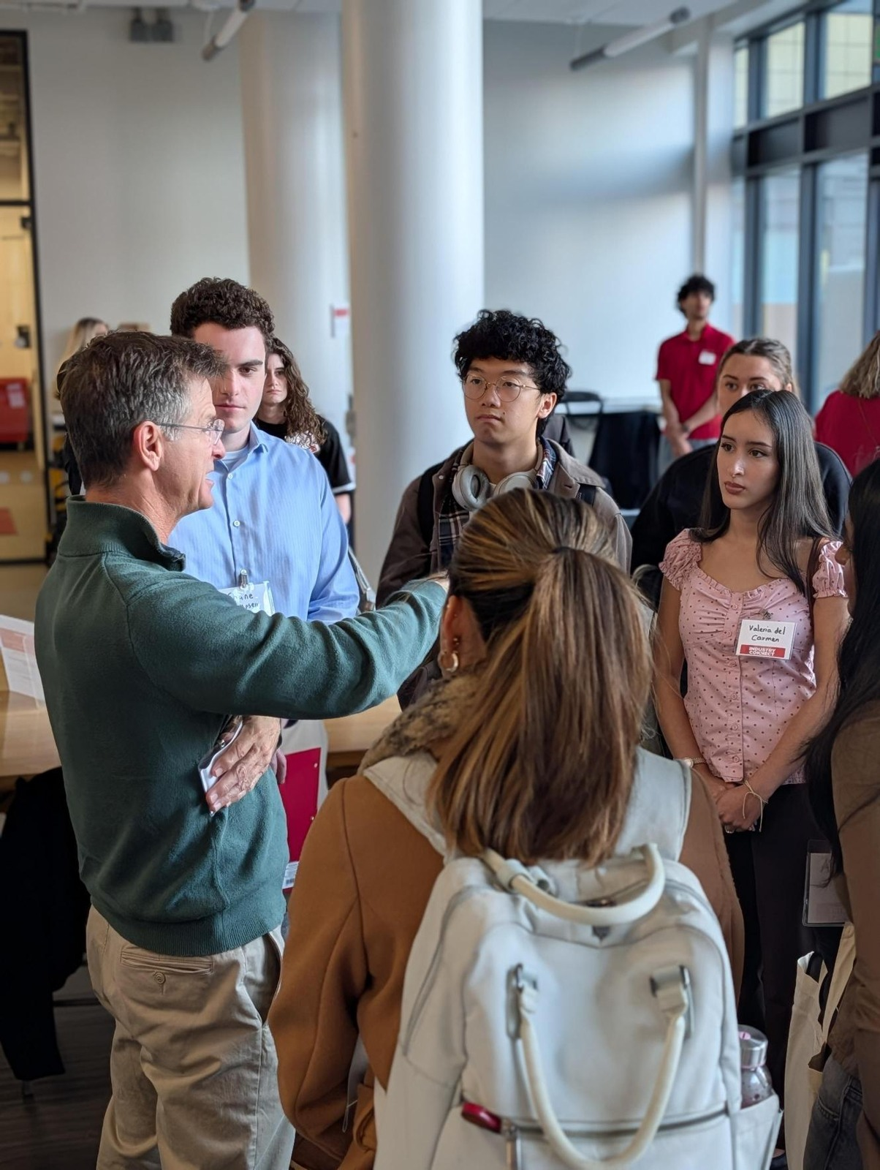
Useful feedback
PERSONAL ACTION
“The clearest action I heard was…”
COMPETENCY CONNECTION
“That fits this behavior because…”
ONE REVISION
“I still need to understand…”
14
Notes:
LESSON: Career Readiness Through Student Leadership
SLIDE 14 OF 24
SESSION TIMING: 32–46 minutes
FACILITATOR GUIDE
Practice from 32 to 46 minutes
32–35: Students choose an employer or graduate-school audience and draft from the Practice explaining the experience handout. Use its model responses to demonstrate a completed answer if needed. 35–38: Partner A speaks for 60–90 seconds; Partner B gives feedback for the remainder. 38–41: Swap. 41–43: Both revise. 43–46: Each delivers a revised answer for about one minute.
Instructions for the listener:
“Name one specific action you heard. Point out one connection you understood. Ask for one missing detail or a clearer link to the chosen audience. Avoid general feedback such as ‘good job.’”
Check participation and transition:
Watch for practice actually occurring, not only writing. Offer an equivalent private recording, written exchange, or instructor conversation when needed. Say: “You have reflected, connected, explained, and revised. Let us check the ideas behind that process.”
How to judge the work
Use the feedback checklist in Practice explaining the experience. An adequate response identifies a real action, supports a plausible competency connection, describes an honest outcome or learning, and explains relevance to the chosen audience. Ask students to revise missing elements. Do not score personal disclosure, accent, confidence, access to prestigious experiences, or a self-rated proficiency level.
Assess evidence and reasoning. Do not rate accent, confidence, disclosure, or the prestige of an experience.
SOURCE GUIDE
/Users/wj85/.codex/outputs/career-readiness-lessons/complete-library/03-nace-student-leadership-facilitator-guide.docx
SOURCES
Adapted from CES Presentation Library: 2025 CORE_Transferable Skills.pptx, slides 8–15; NACE & Suitable Overview 2026.pptx, slides 23–30.
Reflection and growth prompts informed by Professional Skills Self Reflection.pdf, pages 3–4, courtesy of Michele Baran, Life Design Solutions, LLC.
NACE competency framework: https://www.naceweb.org/career-readiness/competencies/career-readiness-defined
Fictional cases, audience-specific model responses, activities, timing, questions, and feedback checklist are newly developed adaptations. Models illustrate the case; they are not claims about actual Rutgers students.
https://www.naceweb.org/career-readiness/competencies/career-readiness-defined
PHOTO
/Users/wj85/Library/CloudStorage/OneDrive-RutgersUniversity/0 - Shared Department Files/Department-wide/Communications and Marketing/Photo Library/2026-2027 Academic Year/Industry Connect - Arts, Media, and Communications/Media (14).jpeg
Photograph is illustrative. People shown are not the fictional case participants.

Slide 15
Knowledge check 1
Which statement provides the strongest evidence of teamwork?
A
I am a team player
B
I belong to three organizations
C
I agreed on roles with teammates and followed through on my tasks
D
I prefer working with others
15
Notes:
LESSON: Career Readiness Through Student Leadership
SLIDE 15 OF 24
SESSION TIMING: Closing reinforcement
FACILITATOR GUIDE
Reinforcement from 46 to 56 minutes
Use the eight questions in the Closing quiz instructor key. In Kahoot, enter the four choices and mark the labeled correct answer before class. No live game is supplied. Without technology, read the question and choices, give thinking time, and have everyone show A/B/C/D together. Allow about 25 seconds to answer and 35 seconds to explain each item; reserve two minutes to revisit the most difficult idea.
Say to students:
“For the quiz, choose the strongest answer from the options. In real experiences, more than one competency can be supported. After each question, I will explain why the answer is the best fit.”
After an incorrect response:
Read the answer explanation in the instructor key. Ask “What detail in the question supports that choice?” Explain the distinction rather than judging the student’s overall ability. If several students miss the same item, use one example from the teaching table before moving on.
INSTRUCTOR ANSWER KEY
Correct answer: C. I agreed on roles with teammates and followed through on my tasks
Explanation: Evidence describes actions, rather than a preference or membership.
Accept A/B/C/D cards, fingers, chat, polling, or a Kahoot created from these items. Ask for a rationale before giving feedback. Answers are in notes only.
SOURCE GUIDE
/Users/wj85/.codex/outputs/career-readiness-lessons/complete-library/03-nace-student-leadership-facilitator-guide.docx
SOURCES
Adapted from CES Presentation Library: 2025 CORE_Transferable Skills.pptx, slides 8–15; NACE & Suitable Overview 2026.pptx, slides 23–30.
Reflection and growth prompts informed by Professional Skills Self Reflection.pdf, pages 3–4, courtesy of Michele Baran, Life Design Solutions, LLC.
NACE competency framework: https://www.naceweb.org/career-readiness/competencies/career-readiness-defined
Fictional cases, audience-specific model responses, activities, timing, questions, and feedback checklist are newly developed adaptations. Models illustrate the case; they are not claims about actual Rutgers students.
https://www.naceweb.org/career-readiness/competencies/career-readiness-defined

Slide 16
Knowledge check 2
A student compares sources to choose a solution. Which competency is most directly demonstrated?
A
Critical Thinking
B
Technology
C
Professionalism
D
Career and Self-Development
16
Notes:
LESSON: Career Readiness Through Student Leadership
SLIDE 16 OF 24
SESSION TIMING: Closing reinforcement
FACILITATOR GUIDE
Reinforcement from 46 to 56 minutes
Use the eight questions in the Closing quiz instructor key. In Kahoot, enter the four choices and mark the labeled correct answer before class. No live game is supplied. Without technology, read the question and choices, give thinking time, and have everyone show A/B/C/D together. Allow about 25 seconds to answer and 35 seconds to explain each item; reserve two minutes to revisit the most difficult idea.
Say to students:
“For the quiz, choose the strongest answer from the options. In real experiences, more than one competency can be supported. After each question, I will explain why the answer is the best fit.”
After an incorrect response:
Read the answer explanation in the instructor key. Ask “What detail in the question supports that choice?” Explain the distinction rather than judging the student’s overall ability. If several students miss the same item, use one example from the teaching table before moving on.
INSTRUCTOR ANSWER KEY
Correct answer: A. Critical Thinking
Explanation: Evaluating information to support a decision demonstrates critical thinking.
Accept A/B/C/D cards, fingers, chat, polling, or a Kahoot created from these items. Ask for a rationale before giving feedback. Answers are in notes only.
SOURCE GUIDE
/Users/wj85/.codex/outputs/career-readiness-lessons/complete-library/03-nace-student-leadership-facilitator-guide.docx
SOURCES
Adapted from CES Presentation Library: 2025 CORE_Transferable Skills.pptx, slides 8–15; NACE & Suitable Overview 2026.pptx, slides 23–30.
Reflection and growth prompts informed by Professional Skills Self Reflection.pdf, pages 3–4, courtesy of Michele Baran, Life Design Solutions, LLC.
NACE competency framework: https://www.naceweb.org/career-readiness/competencies/career-readiness-defined
Fictional cases, audience-specific model responses, activities, timing, questions, and feedback checklist are newly developed adaptations. Models illustrate the case; they are not claims about actual Rutgers students.
https://www.naceweb.org/career-readiness/competencies/career-readiness-defined

Slide 17
Knowledge check 3
Which action most directly demonstrates communication?
A
Buying a new laptop
B
Choosing a major
C
Arriving early
D
Checking that others understood the project instructions
17
Notes:
LESSON: Career Readiness Through Student Leadership
SLIDE 17 OF 24
SESSION TIMING: Closing reinforcement
FACILITATOR GUIDE
Reinforcement from 46 to 56 minutes
Use the eight questions in the Closing quiz instructor key. In Kahoot, enter the four choices and mark the labeled correct answer before class. No live game is supplied. Without technology, read the question and choices, give thinking time, and have everyone show A/B/C/D together. Allow about 25 seconds to answer and 35 seconds to explain each item; reserve two minutes to revisit the most difficult idea.
Say to students:
“For the quiz, choose the strongest answer from the options. In real experiences, more than one competency can be supported. After each question, I will explain why the answer is the best fit.”
After an incorrect response:
Read the answer explanation in the instructor key. Ask “What detail in the question supports that choice?” Explain the distinction rather than judging the student’s overall ability. If several students miss the same item, use one example from the teaching table before moving on.
INSTRUCTOR ANSWER KEY
Correct answer: D. Checking that others understood the project instructions
Explanation: Checking shared understanding is a communication behavior.
Accept A/B/C/D cards, fingers, chat, polling, or a Kahoot created from these items. Ask for a rationale before giving feedback. Answers are in notes only.
SOURCE GUIDE
/Users/wj85/.codex/outputs/career-readiness-lessons/complete-library/03-nace-student-leadership-facilitator-guide.docx
SOURCES
Adapted from CES Presentation Library: 2025 CORE_Transferable Skills.pptx, slides 8–15; NACE & Suitable Overview 2026.pptx, slides 23–30.
Reflection and growth prompts informed by Professional Skills Self Reflection.pdf, pages 3–4, courtesy of Michele Baran, Life Design Solutions, LLC.
NACE competency framework: https://www.naceweb.org/career-readiness/competencies/career-readiness-defined
Fictional cases, audience-specific model responses, activities, timing, questions, and feedback checklist are newly developed adaptations. Models illustrate the case; they are not claims about actual Rutgers students.
https://www.naceweb.org/career-readiness/competencies/career-readiness-defined

Slide 18
Knowledge check 4
Jordan addresses participation barriers after listening to students. Which competency is the strongest fit?
A
Equity and Inclusion
B
Technology because registration is online
C
Leadership solely because Jordan is an officer
D
Professionalism because the event has a schedule
18
Notes:
LESSON: Career Readiness Through Student Leadership
SLIDE 18 OF 24
SESSION TIMING: Closing reinforcement
FACILITATOR GUIDE
Reinforcement from 46 to 56 minutes
Use the eight questions in the Closing quiz instructor key. In Kahoot, enter the four choices and mark the labeled correct answer before class. No live game is supplied. Without technology, read the question and choices, give thinking time, and have everyone show A/B/C/D together. Allow about 25 seconds to answer and 35 seconds to explain each item; reserve two minutes to revisit the most difficult idea.
Say to students:
“For the quiz, choose the strongest answer from the options. In real experiences, more than one competency can be supported. After each question, I will explain why the answer is the best fit.”
After an incorrect response:
Read the answer explanation in the instructor key. Ask “What detail in the question supports that choice?” Explain the distinction rather than judging the student’s overall ability. If several students miss the same item, use one example from the teaching table before moving on.
INSTRUCTOR ANSWER KEY
Correct answer: A. Equity and Inclusion
Explanation: Equity and Inclusion: listening to perspectives and addressing participation barriers. Other connections require their own evidence.
Accept A/B/C/D cards, fingers, chat, polling, or a Kahoot created from these items. Ask for a rationale before giving feedback. Answers are in notes only.
SOURCE GUIDE
/Users/wj85/.codex/outputs/career-readiness-lessons/complete-library/03-nace-student-leadership-facilitator-guide.docx
SOURCES
Adapted from CES Presentation Library: 2025 CORE_Transferable Skills.pptx, slides 8–15; NACE & Suitable Overview 2026.pptx, slides 23–30.
Reflection and growth prompts informed by Professional Skills Self Reflection.pdf, pages 3–4, courtesy of Michele Baran, Life Design Solutions, LLC.
NACE competency framework: https://www.naceweb.org/career-readiness/competencies/career-readiness-defined
Fictional cases, audience-specific model responses, activities, timing, questions, and feedback checklist are newly developed adaptations. Models illustrate the case; they are not claims about actual Rutgers students.
https://www.naceweb.org/career-readiness/competencies/career-readiness-defined

Slide 19
Knowledge check 5
Which explanation best connects an experience to a competency?
A
The experience title proves the skill
B
A specific personal action plus evidence and an explanation
C
A list of all eight competencies without examples
D
A claim that the entire team succeeded
19
Notes:
LESSON: Career Readiness Through Student Leadership
SLIDE 19 OF 24
SESSION TIMING: Closing reinforcement
FACILITATOR GUIDE
Reinforcement from 46 to 56 minutes
Use the eight questions in the Closing quiz instructor key. In Kahoot, enter the four choices and mark the labeled correct answer before class. No live game is supplied. Without technology, read the question and choices, give thinking time, and have everyone show A/B/C/D together. Allow about 25 seconds to answer and 35 seconds to explain each item; reserve two minutes to revisit the most difficult idea.
Say to students:
“For the quiz, choose the strongest answer from the options. In real experiences, more than one competency can be supported. After each question, I will explain why the answer is the best fit.”
After an incorrect response:
Read the answer explanation in the instructor key. Ask “What detail in the question supports that choice?” Explain the distinction rather than judging the student’s overall ability. If several students miss the same item, use one example from the teaching table before moving on.
INSTRUCTOR ANSWER KEY
Correct answer: B. A specific personal action plus evidence and an explanation
Explanation: A defensible connection identifies the student’s action and explains what supports the claim.
Accept A/B/C/D cards, fingers, chat, polling, or a Kahoot created from these items. Ask for a rationale before giving feedback. Answers are in notes only.
SOURCE GUIDE
/Users/wj85/.codex/outputs/career-readiness-lessons/complete-library/03-nace-student-leadership-facilitator-guide.docx
SOURCES
Adapted from CES Presentation Library: 2025 CORE_Transferable Skills.pptx, slides 8–15; NACE & Suitable Overview 2026.pptx, slides 23–30.
Reflection and growth prompts informed by Professional Skills Self Reflection.pdf, pages 3–4, courtesy of Michele Baran, Life Design Solutions, LLC.
NACE competency framework: https://www.naceweb.org/career-readiness/competencies/career-readiness-defined
Fictional cases, audience-specific model responses, activities, timing, questions, and feedback checklist are newly developed adaptations. Models illustrate the case; they are not claims about actual Rutgers students.
https://www.naceweb.org/career-readiness/competencies/career-readiness-defined

Slide 20
Knowledge check 6
What should change when explaining the same experience to a graduate-school audience?
A
Invent a more impressive result
B
Remove all reference to personal actions
C
Connect the learning to academic questions and readiness for advanced study
D
Use the same generic closing for every program
20
Notes:
LESSON: Career Readiness Through Student Leadership
SLIDE 20 OF 24
SESSION TIMING: Closing reinforcement
FACILITATOR GUIDE
Reinforcement from 46 to 56 minutes
Use the eight questions in the Closing quiz instructor key. In Kahoot, enter the four choices and mark the labeled correct answer before class. No live game is supplied. Without technology, read the question and choices, give thinking time, and have everyone show A/B/C/D together. Allow about 25 seconds to answer and 35 seconds to explain each item; reserve two minutes to revisit the most difficult idea.
Say to students:
“For the quiz, choose the strongest answer from the options. In real experiences, more than one competency can be supported. After each question, I will explain why the answer is the best fit.”
After an incorrect response:
Read the answer explanation in the instructor key. Ask “What detail in the question supports that choice?” Explain the distinction rather than judging the student’s overall ability. If several students miss the same item, use one example from the teaching table before moving on.
INSTRUCTOR ANSWER KEY
Correct answer: C. Connect the learning to academic questions and readiness for advanced study
Explanation: Keep the facts accurate and adapt the relevance to the program and purpose.
Accept A/B/C/D cards, fingers, chat, polling, or a Kahoot created from these items. Ask for a rationale before giving feedback. Answers are in notes only.
SOURCE GUIDE
/Users/wj85/.codex/outputs/career-readiness-lessons/complete-library/03-nace-student-leadership-facilitator-guide.docx
SOURCES
Adapted from CES Presentation Library: 2025 CORE_Transferable Skills.pptx, slides 8–15; NACE & Suitable Overview 2026.pptx, slides 23–30.
Reflection and growth prompts informed by Professional Skills Self Reflection.pdf, pages 3–4, courtesy of Michele Baran, Life Design Solutions, LLC.
NACE competency framework: https://www.naceweb.org/career-readiness/competencies/career-readiness-defined
Fictional cases, audience-specific model responses, activities, timing, questions, and feedback checklist are newly developed adaptations. Models illustrate the case; they are not claims about actual Rutgers students.
https://www.naceweb.org/career-readiness/competencies/career-readiness-defined

Slide 21
Knowledge check 7
You cannot show a successful final result. What is the most useful response?
A
State an honest outcome, feedback, or learning and explain your next step
B
Make up a percentage improvement
C
Avoid describing what you personally did
D
Say the experience taught every competency equally
21
Notes:
LESSON: Career Readiness Through Student Leadership
SLIDE 21 OF 24
SESSION TIMING: Closing reinforcement
FACILITATOR GUIDE
Reinforcement from 46 to 56 minutes
Use the eight questions in the Closing quiz instructor key. In Kahoot, enter the four choices and mark the labeled correct answer before class. No live game is supplied. Without technology, read the question and choices, give thinking time, and have everyone show A/B/C/D together. Allow about 25 seconds to answer and 35 seconds to explain each item; reserve two minutes to revisit the most difficult idea.
Say to students:
“For the quiz, choose the strongest answer from the options. In real experiences, more than one competency can be supported. After each question, I will explain why the answer is the best fit.”
After an incorrect response:
Read the answer explanation in the instructor key. Ask “What detail in the question supports that choice?” Explain the distinction rather than judging the student’s overall ability. If several students miss the same item, use one example from the teaching table before moving on.
INSTRUCTOR ANSWER KEY
Correct answer: A. State an honest outcome, feedback, or learning and explain your next step
Explanation: Reflection can draw evidence from learning and revision without inventing success.
Accept A/B/C/D cards, fingers, chat, polling, or a Kahoot created from these items. Ask for a rationale before giving feedback. Answers are in notes only.
SOURCE GUIDE
/Users/wj85/.codex/outputs/career-readiness-lessons/complete-library/03-nace-student-leadership-facilitator-guide.docx
SOURCES
Adapted from CES Presentation Library: 2025 CORE_Transferable Skills.pptx, slides 8–15; NACE & Suitable Overview 2026.pptx, slides 23–30.
Reflection and growth prompts informed by Professional Skills Self Reflection.pdf, pages 3–4, courtesy of Michele Baran, Life Design Solutions, LLC.
NACE competency framework: https://www.naceweb.org/career-readiness/competencies/career-readiness-defined
Fictional cases, audience-specific model responses, activities, timing, questions, and feedback checklist are newly developed adaptations. Models illustrate the case; they are not claims about actual Rutgers students.
https://www.naceweb.org/career-readiness/competencies/career-readiness-defined

Slide 22
Knowledge check 8
Which response best uses peer feedback?
A
Memorize the competency definition only
B
Keep the first answer even if it is unclear
C
Add more labels without evidence
D
Revise the example, explain its relevance, and practice it again
22
Notes:
LESSON: Career Readiness Through Student Leadership
SLIDE 22 OF 24
SESSION TIMING: Closing reinforcement
FACILITATOR GUIDE
Reinforcement from 46 to 56 minutes
Use the eight questions in the Closing quiz instructor key. In Kahoot, enter the four choices and mark the labeled correct answer before class. No live game is supplied. Without technology, read the question and choices, give thinking time, and have everyone show A/B/C/D together. Allow about 25 seconds to answer and 35 seconds to explain each item; reserve two minutes to revisit the most difficult idea.
Say to students:
“For the quiz, choose the strongest answer from the options. In real experiences, more than one competency can be supported. After each question, I will explain why the answer is the best fit.”
After an incorrect response:
Read the answer explanation in the instructor key. Ask “What detail in the question supports that choice?” Explain the distinction rather than judging the student’s overall ability. If several students miss the same item, use one example from the teaching table before moving on.
INSTRUCTOR ANSWER KEY
Correct answer: D. Revise the example, explain its relevance, and practice it again
Explanation: A stronger explanation improves through evidence, audience relevance, and another attempt.
Accept A/B/C/D cards, fingers, chat, polling, or a Kahoot created from these items. Ask for a rationale before giving feedback. Answers are in notes only.
SOURCE GUIDE
/Users/wj85/.codex/outputs/career-readiness-lessons/complete-library/03-nace-student-leadership-facilitator-guide.docx
SOURCES
Adapted from CES Presentation Library: 2025 CORE_Transferable Skills.pptx, slides 8–15; NACE & Suitable Overview 2026.pptx, slides 23–30.
Reflection and growth prompts informed by Professional Skills Self Reflection.pdf, pages 3–4, courtesy of Michele Baran, Life Design Solutions, LLC.
NACE competency framework: https://www.naceweb.org/career-readiness/competencies/career-readiness-defined
Fictional cases, audience-specific model responses, activities, timing, questions, and feedback checklist are newly developed adaptations. Models illustrate the case; they are not claims about actual Rutgers students.
https://www.naceweb.org/career-readiness/competencies/career-readiness-defined

Slide 23
Your next growth action
One example. One supported competency connection. One action to practice.
What changed after feedback? When will you practice, and who will help you check progress?
Notes:
LESSON: Career Readiness Through Student Leadership
SLIDE 23 OF 24
SESSION TIMING: 56–60 minutes
FACILITATOR GUIDE
Exit and close from 56 to 60 minutes
Give two minutes to submit the revised evidence statement, one change made after feedback, and a growth action with a date or feedback source. Use one minute to invite a voluntary example and one minute to close.
Say to students:
“The experience title does not tell your whole story. What you did, how you learned, and how you explain the connection make your skills visible. Keep your revised example and revisit your practice goal. The next time you describe this experience, choose the details that matter to that listener.”
Suggested context-specific growth action: For the next event, seek feedback from two people whose perspectives were not represented and document one resulting design change.
SOURCE GUIDE
/Users/wj85/.codex/outputs/career-readiness-lessons/complete-library/03-nace-student-leadership-facilitator-guide.docx
SOURCES
Adapted from CES Presentation Library: 2025 CORE_Transferable Skills.pptx, slides 8–15; NACE & Suitable Overview 2026.pptx, slides 23–30.
Reflection and growth prompts informed by Professional Skills Self Reflection.pdf, pages 3–4, courtesy of Michele Baran, Life Design Solutions, LLC.
NACE competency framework: https://www.naceweb.org/career-readiness/competencies/career-readiness-defined
Fictional cases, audience-specific model responses, activities, timing, questions, and feedback checklist are newly developed adaptations. Models illustrate the case; they are not claims about actual Rutgers students.
https://www.naceweb.org/career-readiness/competencies/career-readiness-defined

Slide 24
Resources for your next step
01
NACE definitions and sample behaviors
naceweb.org
02
CES Career & Internship Guide
careers.rutgers.edu/students-alumni/career-internship-guide
03
Campus partner resources
careers.rutgers.edu/campus-partners/explore-role
24
Notes:
LESSON: Career Readiness Through Student Leadership
SLIDE 24 OF 24
SESSION TIMING: After the closing commitment
FACILITATOR GUIDE
Relevant Rutgers support
Student leadership resources: https://careers.rutgers.edu/campus-partners/explore-role
CES advising and resources: https://careers.rutgers.edu/students-and-alumni
These workshop activities do not automatically qualify for We R Career-Ready Challenge points or rewards. Use the current partner and student guidance before making any participation claim.
Sources and adaptation
CES Campus Partners: https://careers.rutgers.edu/campus-partners
CES Find Your Role: https://careers.rutgers.edu/campus-partners/explore-role
CES Roadmap and Frameworks: https://careers.rutgers.edu/campus-partners/strategicplan-2030
CES Becoming Career Ready: https://careers.rutgers.edu/news/becoming-career-ready
CES Are You Ready for a Behavioral Interview: https://careers.rutgers.edu/news/are-you-ready-behavioral-interview
Rutgers Newark STAR Method: https://cdn.careers.newark.rutgers.edu/wp-content/uploads/sites/90/2022/07/STAR-Method.pdf
CES Authoring Your Value Personal Statement: https://careers.rutgers.edu/news/authoring-your-value-personal-statement
NACE competency definitions and behaviors: https://www.naceweb.org/career-readiness/competencies/career-readiness-defined
Source materials: CES Presentation Library, 2025 CORE_Transferable Skills.pptx and NACE & Suitable Overview 2026.pptx; Professional Skills Self Reflection.pdf, courtesy of Michele Baran, Life Design Solutions, LLC. Cases, scripts, responses, and activities are instructional adaptations; fictional examples are not actual Rutgers outcomes.
SOURCE GUIDE
/Users/wj85/.codex/outputs/career-readiness-lessons/complete-library/03-nace-student-leadership-facilitator-guide.docx
SOURCES
Adapted from CES Presentation Library: 2025 CORE_Transferable Skills.pptx, slides 8–15; NACE & Suitable Overview 2026.pptx, slides 23–30.
Reflection and growth prompts informed by Professional Skills Self Reflection.pdf, pages 3–4, courtesy of Michele Baran, Life Design Solutions, LLC.
NACE competency framework: https://www.naceweb.org/career-readiness/competencies/career-readiness-defined
Fictional cases, audience-specific model responses, activities, timing, questions, and feedback checklist are newly developed adaptations. Models illustrate the case; they are not claims about actual Rutgers students.
https://www.naceweb.org/career-readiness/competencies/career-readiness-defined

