Slide 1


YOUR CAREER JOURNEY
Build Your Career
Journey Roadmap
Connect your learning, experiences, and next steps.
Notes:
LESSON: Build Your Career Journey Roadmap
SLIDE 1 OF 16
FACILITATOR GUIDE
Preparation and materials
Read the background and rehearse the model example before teaching. Print the two roadmap worksheet pages and resource menu, or share editable digital copies. Have the four phase names, resource menu, timer, and board or shared document ready. Students do not need to log into tools or complete an assessment during this session.
Facilitator background
CES means Career Exploration and Success. The Career Journey organizes recurring development questions. It is not a test, a ranking, or a requirement to complete one phase per year. Students can explore, develop skills, and pursue opportunities at the same time; a new experience may lead them back to self-discovery.
How the phases connect
Self-discovery informs which careers to explore. Career exploration helps identify academic routes and experiences to investigate. Those experiences develop abilities and provide evidence to explain. Pursuing goals puts preparation into action. New information can send a student back to any earlier question. A resource may support several phases; its purpose in the student’s plan determines the fit.
Thirty minute option
Use 0–3 for the opening, 3–7 for phase matching, 7–12 for the resource challenge, 12–23 for a first-draft roadmap, 23–28 for peer review, and 28–30 for the commitment. Use the printed menu instead of live browsing. Partners review one row each. Students still draft all four phases; ask them to refine the roadmap afterward.
SOURCE GUIDE
/Users/wj85/.codex/outputs/career-readiness-lessons/complete-library/01-career-journey-facilitator-guide.docx
SOURCES
https://careers.rutgers.edu/students-alumni/career-internship-guide
https://careers.rutgers.edu/students-and-alumni/onlinetools
https://careers.rutgers.edu/campus-partners/strategicplan-2030
PHOTO
/Users/wj85/Library/CloudStorage/OneDrive-RutgersUniversity/0 - Shared Department Files/Department-wide/Communications and Marketing/Photo Library/Rutgers (R-Comm)/NR23CACStudentBanner5723sm.JPG
Photograph is illustrative. People shown are not the fictional case participants.
DELIVERY
Move directly to the opening student activity after a brief welcome. Full instructions, worksheets, and accessibility alternatives are in the matching facilitator guide. This deck uses CES branding only.

Slide 2
Your starting question
What do you most want to understand or move forward in your career journey?
Choose a question. Share with a partner. You can revisit more than one phase.
Notes:
LESSON: Build Your Career Journey Roadmap
SLIDE 2 OF 16
SESSION TIMING: 0–4 minutes
FACILITATOR GUIDE
0 to 4 minutes Choose a starting question
Facilitator actions:
Give one minute to write, one minute to choose a kind of help, and two minutes to exchange with a partner and hear two responses.
Say to students:
“Write a question about your future. Would it help most to understand yourself, explore possibilities, practice a skill, or pursue an opportunity? Choose one and tell a partner why.”
Expected responses:
A question and reason for the chosen focus.
If students need support:
Offer “What do I enjoy learning?” or “How can I explore one career?” Students can use a fictional question.
Transition to the next activity:
“These four kinds of help connect with the Career Journey.”
SOURCE GUIDE
/Users/wj85/.codex/outputs/career-readiness-lessons/complete-library/01-career-journey-facilitator-guide.docx
SOURCES
https://careers.rutgers.edu/students-alumni/career-internship-guide
https://careers.rutgers.edu/students-and-alumni/onlinetools
https://careers.rutgers.edu/campus-partners/strategicplan-2030

Slide 3
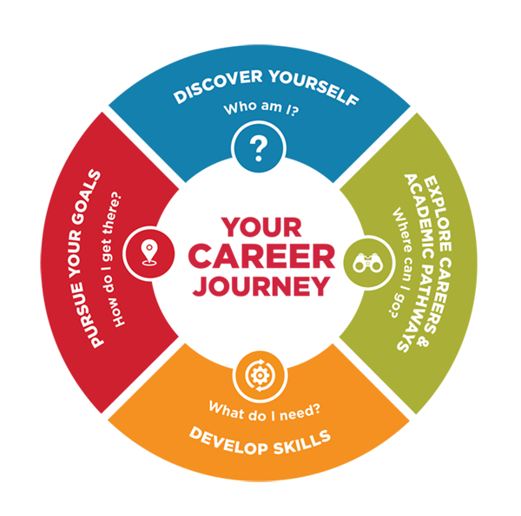
The Career Journey Model
Discover Yourself
Interests, skills, values, and preferences
Explore Careers and Academic Pathways
Career possibilities and multiple routes
Develop Skills
Experience, reflection, and articulation
Pursue Your Goals
Job search, graduate study, and next steps
03
Notes:
LESSON: Build Your Career Journey Roadmap
SLIDE 3 OF 16
SESSION TIMING: 4–10 minutes
FACILITATOR GUIDE
How the phases connect
Self-discovery informs which careers to explore. Career exploration helps identify academic routes and experiences to investigate. Those experiences develop abilities and provide evidence to explain. Pursuing goals puts preparation into action. New information can send a student back to any earlier question. A resource may support several phases; its purpose in the student’s plan determines the fit.
Explain what progress means
Students will draft a plan for developing in every phase, not certify permanent mastery. Progress should be observable: naming values and supporting them with examples, comparing possibilities using information, applying feedback to a skill, or completing an application step. Attending an event is an action; explaining what it helped you understand is a progress check.
A brief introduction you can say aloud
Use this explanation during minutes 4–6, then move directly into the matching activity. These are suggested words based on how CES explains the model to students.
SOURCE GUIDE
/Users/wj85/.codex/outputs/career-readiness-lessons/complete-library/01-career-journey-facilitator-guide.docx
SOURCES
https://careers.rutgers.edu/students-alumni/career-internship-guide
https://careers.rutgers.edu/students-and-alumni/onlinetools
https://careers.rutgers.edu/campus-partners/strategicplan-2030
Graphic: https://careers.rutgers.edu/sites/default/files/2024-03/FourStageCounseling_2.24.22_web.png

Slide 4

Discover Yourself
NOTICE
Your interests, skills, strengths, values, motivations, and preferences
INTERPRET
Use experiences and feedback to understand possible patterns.
REVISIT
Treat what you learn as a starting point for exploration.
04
Notes:
LESSON: Build Your Career Journey Roadmap
SLIDE 4 OF 16
SESSION TIMING: 4–10 minutes
FACILITATOR GUIDE
Discover Yourself
“Start by learning about your interests, skills, values, and preferences. What do you enjoy? What matters to you? What environments help you do your best? That knowledge gives you a starting point for exploring possibilities.”
Discover Yourself
Traitify through CES Online Tools; CES career advising.
Use a self-discovery tool or advising conversation to examine interests, skills, values, and preferences. Treat results as a discussion starting point, not a prescribed career.
Discover Yourself
Interests, skills, values, or preferences I want to understand
________________________________________________________________________________
Action I will take while at Rutgers
________________________________________________________________________________
CES resource and how I will use it
________________________________________________________________________________
Target date or campus milestone
________________________________________________________________________________
Evidence of progress and what I will do if I get stuck
________________________________________________________________________________
SOURCE GUIDE
/Users/wj85/.codex/outputs/career-readiness-lessons/complete-library/01-career-journey-facilitator-guide.docx
SOURCES
https://careers.rutgers.edu/students-alumni/career-internship-guide
https://careers.rutgers.edu/students-and-alumni/onlinetools
https://careers.rutgers.edu/campus-partners/strategicplan-2030
PHOTO
/Users/wj85/Desktop/Dropbox/Rutgers Work/Marketing & Communications/Marketing Items/Photos/2018-2019 Academic Year/FALL/Fall Staged Shoot-Manny 2018_11_20/Fall Staged Shoot (5 Stars)/Fall Shoot-5 Star-54.jpg
Photograph is illustrative. People shown are not the fictional case participants.

Slide 5
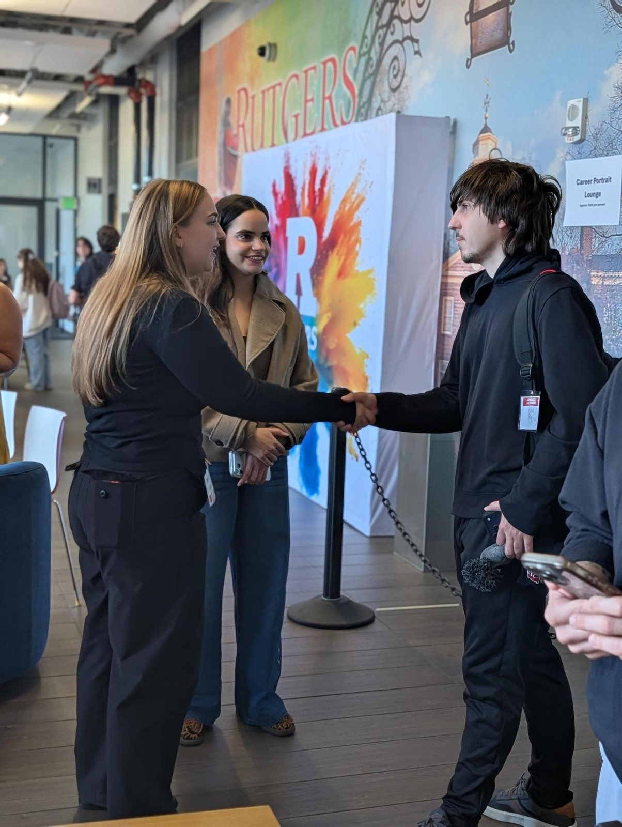
Explore Careers and Academic Pathways
CONNECT
Link what you learn about yourself to several career possibilities.
COMPARE
Investigate the work and multiple academic routes.
TEST
Use credible information and conversations to evaluate fit.
05
Notes:
LESSON: Build Your Career Journey Roadmap
SLIDE 5 OF 16
SESSION TIMING: 4–10 minutes
FACILITATOR GUIDE
Explore Careers and Academic Pathways
“Connect what you learned about yourself to different careers, then investigate the academic routes that can lead there. There may be several careers that fit you and several academic pathways toward a career. For investment banking, for example, you might investigate finance and economics pathways. Ask what preparation each route would involve.”
Explore Careers and Academic Pathways
Scarlet Career Mentoring Network, including Student-Alumni Career Connect; Career and Internship Guide.
Compare several careers that connect with your self-discovery. Ask a mentor about routes into one field and investigate more than one relevant major or academic program.
Explore Careers and Academic Pathways
Careers that fit me and academic pathways I will compare
________________________________________________________________________________
Action I will take while at Rutgers
________________________________________________________________________________
CES resource and how I will use it
________________________________________________________________________________
Target date or campus milestone
________________________________________________________________________________
Evidence of progress and what I will do if I get stuck
________________________________________________________________________________
SOURCE GUIDE
/Users/wj85/.codex/outputs/career-readiness-lessons/complete-library/01-career-journey-facilitator-guide.docx
SOURCES
https://careers.rutgers.edu/students-alumni/career-internship-guide
https://careers.rutgers.edu/students-and-alumni/onlinetools
https://careers.rutgers.edu/campus-partners/strategicplan-2030
PHOTO
/Users/wj85/Library/CloudStorage/OneDrive-RutgersUniversity/0 - Shared Department Files/Department-wide/Communications and Marketing/Photo Library/2026-2027 Academic Year/Industry Connect - Arts, Media, and Communications/Media.jpeg
Photograph is illustrative. People shown are not the fictional case participants.

Slide 6
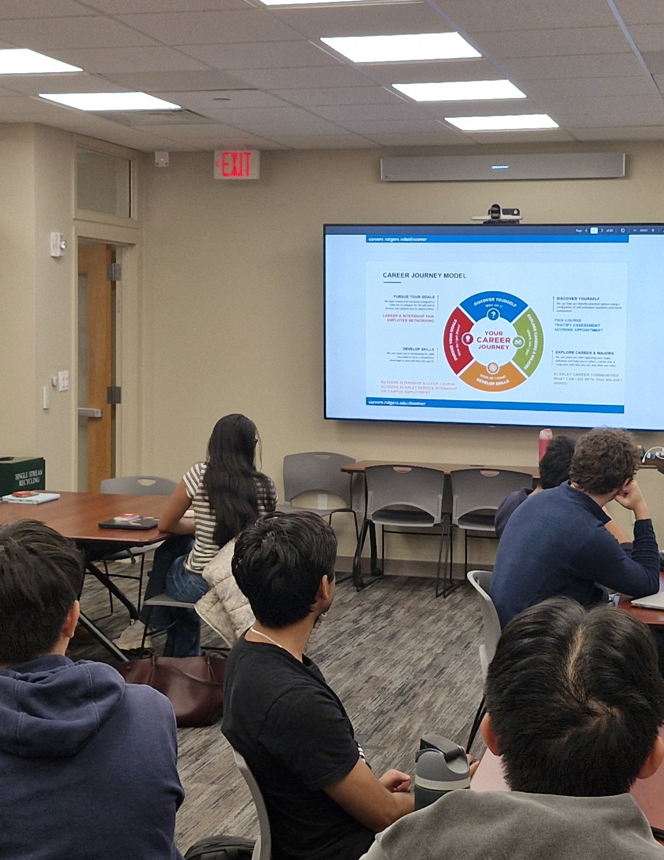
Develop Skills
EXPERIENCE
Practice through projects, work, leadership, research, and field experiences.
REFLECT
Connect personal actions to NACE competency behaviors.
EXPLAIN
Practice articulating your learning for an employer or graduate program.
06
Notes:
LESSON: Build Your Career Journey Roadmap
SLIDE 6 OF 16
SESSION TIMING: 4–10 minutes
FACILITATOR GUIDE
Develop Skills
“Build the skills and competencies that prepare you for future work or study. NACE—the National Association of Colleges and Employers—provides a useful career readiness framework. Internships, co-ops, lab work, class projects, and other experiences can help you develop. Reflect on what happened, connect your actions to competencies, and practice explaining that evidence to an employer or graduate-school representative.”
Develop Skills
Forage through CES Online Tools; Rutgers Internship and Co-op Course; Student Employee Enrichment.
Choose an experience that helps you practice relevant skills. Reflect on your actions, connect them to NACE competencies, and practice explaining the evidence. Academic departments and other campus partners also offer lab work, research, and other learning experiences.
Develop Skills
Experience and skills I will develop, reflect on, and explain
________________________________________________________________________________
Action I will take while at Rutgers
________________________________________________________________________________
CES resource and how I will use it
________________________________________________________________________________
Target date or campus milestone
________________________________________________________________________________
Evidence of progress and what I will do if I get stuck
________________________________________________________________________________
SOURCE GUIDE
/Users/wj85/.codex/outputs/career-readiness-lessons/complete-library/01-career-journey-facilitator-guide.docx
SOURCES
https://careers.rutgers.edu/students-alumni/career-internship-guide
https://careers.rutgers.edu/students-and-alumni/onlinetools
https://careers.rutgers.edu/campus-partners/strategicplan-2030
PHOTO
/Users/wj85/Library/CloudStorage/OneDrive-RutgersUniversity/0 - Shared Department Files/Department-wide/Communications and Marketing/Photo Library/2026-2027 Academic Year/FIGS Classes/102126_FIGSCLASS05.jpg
Photograph is illustrative. People shown are not the fictional case participants.

Slide 7

Pursue Your Goals
PREPARE
Practice networking, applications, interviews, and negotiation.
INVESTIGATE
Understand AI in the search and graduate-school processes.
ADAPT
Build alternative routes as goals and opportunities change.
07
Notes:
LESSON: Build Your Career Journey Roadmap
SLIDE 7 OF 16
SESSION TIMING: 4–10 minutes
FACILITATOR GUIDE
Pursue Your Goals
“Put your preparation into action. Learn to network, prepare materials, apply, interview, and negotiate. Use support such as career fairs, resume feedback, and guidance on AI in a job search. This phase also includes researching graduate-program requirements and preparing applications.”
Pursue Your Goals
Rutgers Handshake, Big Interview, and Big Resume through CES Online Tools; Career and Internship Guide; CES workshops and advising.
Plan a search, networking conversation, application, interview, or negotiation step. Use the Guide for AI and the workforce, job-search advice, and graduate-school planning. Use feedback to improve materials and practice.
Pursue Your Goals
Job-search or graduate-school process I will practice
________________________________________________________________________________
Action I will take while at Rutgers
________________________________________________________________________________
CES resource and how I will use it
________________________________________________________________________________
Target date or campus milestone
________________________________________________________________________________
Evidence of progress and what I will do if I get stuck
________________________________________________________________________________
SOURCE GUIDE
/Users/wj85/.codex/outputs/career-readiness-lessons/complete-library/01-career-journey-facilitator-guide.docx
SOURCES
https://careers.rutgers.edu/students-alumni/career-internship-guide
https://careers.rutgers.edu/students-and-alumni/onlinetools
https://careers.rutgers.edu/campus-partners/strategicplan-2030
PHOTO
/Users/wj85/Desktop/Dropbox/Rutgers Work/Marketing & Communications/Marketing Items/Photos/2017-2018 Acamdemic Year/Fall 2017/100917_Mock Interview Clinic/DSC04439.JPG
Photograph is illustrative. People shown are not the fictional case participants.

Slide 8
CES support across the phases
Discover
Self-discovery tools and career advising
Explore
Career communities, mentoring, and career exploration programs
Develop
Experiential opportunities, reflection, and competency practice
Pursue
Handshake, Big Interview, Big Resume, and graduate-school guidance
08
Notes:
LESSON: Build Your Career Journey Roadmap
SLIDE 8 OF 16
SESSION TIMING: 10–18 minutes
FACILITATOR GUIDE
CES resource menu
Student handout. These are starting points, not exclusive matches. A resource can support more than one phase. Use the links below to check access, dates, and program eligibility.
Resource links
CES Online Tools and Handshake access: https://careers.rutgers.edu/students-and-alumni/onlinetools
CES advising and student services: https://careers.rutgers.edu/students-and-alumni
Scarlet Career Mentoring Network: https://careers.rutgers.edu/Mentoring
Career and Internship Guide: https://careers.rutgers.edu/students-alumni/career-internship-guide
CES workshops: https://careers.rutgers.edu/events/workshops
Rutgers Internship and Co-op Course: https://careers.rutgers.edu/students-alumni/courses-signature-programs/rutgers-internship-and-co-op-course-ricc
Student Employee Enrichment: https://careers.rutgers.edu/SEE
Online Tools directs students to Rutgers Handshake resources for several tools. Check current instructions before class. Do not spend the workshop troubleshooting individual logins; students can put accessing a tool on their roadmap.
Resource details and access can change. Use current CES pages to confirm availability and eligibility.
SOURCE GUIDE
/Users/wj85/.codex/outputs/career-readiness-lessons/complete-library/01-career-journey-facilitator-guide.docx
SOURCES
https://careers.rutgers.edu/students-alumni/career-internship-guide
https://careers.rutgers.edu/students-and-alumni/onlinetools
https://careers.rutgers.edu/campus-partners/strategicplan-2030

Slide 9
A CES resource challenge
A
“I am unsure what matters to me in work.”
B
“I want to compare several routes into a field.”
C
“I have experience, but struggle to explain my skills.”
D
“I need practice for interviews or graduate applications.”
Which phase and resource would help? Explain the connection.
09
Notes:
LESSON: Build Your Career Journey Roadmap
SLIDE 9 OF 16
SESSION TIMING: 10–18 minutes
FACILITATOR GUIDE
10 to 18 minutes CES resource challenge
Facilitator actions:
Distribute the resource menu. Read the two cases below. Give pairs three minutes to recommend one resource and a specific use for each case, using the menu or browsing the linked pages. Spend three minutes hearing recommendations and two minutes demonstrating where to find a resource.
Say to students:
“You are the resource advisor. Recommend a tool or service and explain what the student would actually do with it. Naming a website is only the beginning.”
Expected responses:
A resource matched to a need, plus a concrete use.
If students need support:
Ask “What would the student do first after opening that page?” Use the answer guidance below.
Transition to the next activity:
“Use those same connections to build your own roadmap.”
Cases and answer guidance
A student enjoys helping people but does not know which careers to investigate. A reasonable route is self-discovery with Traitify or advising, then a mentoring conversation to investigate a possible path. Ask what the student hopes to learn.
A student wants an internship but has trouble explaining what they learned in a class project. Developing Skills includes reflecting on the project, connecting actions to NACE competencies, and practicing the explanation. Pursue Your Goals includes preparing for the actual interview; Big Interview, CES advising, or interview articles can support that step. Ask students to explain the purpose of their recommendation.
SOURCE GUIDE
/Users/wj85/.codex/outputs/career-readiness-lessons/complete-library/01-career-journey-facilitator-guide.docx
SOURCES
https://careers.rutgers.edu/students-alumni/career-internship-guide
https://careers.rutgers.edu/students-and-alumni/onlinetools
https://careers.rutgers.edu/campus-partners/strategicplan-2030

Slide 10
A useful referral connects need and action
01
02
03
IDENTIFY THE NEED
SELECT SUPPORT
NAME THE ACTION
Which phase best addresses the student’s question?
Which CES resource could help, and why?
What would the student do with that resource?
10
Notes:
LESSON: Build Your Career Journey Roadmap
SLIDE 10 OF 16
SESSION TIMING: 10–18 minutes
FACILITATOR GUIDE
10 to 18 minutes CES resource challenge
Facilitator actions:
Distribute the resource menu. Read the two cases below. Give pairs three minutes to recommend one resource and a specific use for each case, using the menu or browsing the linked pages. Spend three minutes hearing recommendations and two minutes demonstrating where to find a resource.
Say to students:
“You are the resource advisor. Recommend a tool or service and explain what the student would actually do with it. Naming a website is only the beginning.”
Expected responses:
A resource matched to a need, plus a concrete use.
If students need support:
Ask “What would the student do first after opening that page?” Use the answer guidance below.
Transition to the next activity:
“Use those same connections to build your own roadmap.”
Cases and answer guidance
A student enjoys helping people but does not know which careers to investigate. A reasonable route is self-discovery with Traitify or advising, then a mentoring conversation to investigate a possible path. Ask what the student hopes to learn.
A student wants an internship but has trouble explaining what they learned in a class project. Developing Skills includes reflecting on the project, connecting actions to NACE competencies, and practicing the explanation. Pursue Your Goals includes preparing for the actual interview; Big Interview, CES advising, or interview articles can support that step. Ask students to explain the purpose of their recommendation.
SOURCE GUIDE
/Users/wj85/.codex/outputs/career-readiness-lessons/complete-library/01-career-journey-facilitator-guide.docx
SOURCES
https://careers.rutgers.edu/students-alumni/career-internship-guide
https://careers.rutgers.edu/students-and-alumni/onlinetools
https://careers.rutgers.edu/campus-partners/strategicplan-2030

Slide 11
Your campus career roadmap
Discover Yourself
Explore Careers and
Academic Pathways
My action
My support or resource
My date and evidence of progress
My action
My support or resource
My date and evidence of progress
Develop Skills
Pursue Your Goals
My action
My support or resource
My date and evidence of progress
My action
My support or resource
My date and evidence of progress
11
Notes:
LESSON: Build Your Career Journey Roadmap
SLIDE 11 OF 16
SESSION TIMING: 18–33 minutes
FACILITATOR GUIDE
18 to 33 minutes Create a campus roadmap
Facilitator actions:
18–21: Model one row with the example below. 21–31: Students draft all four rows, including an action, CES resource, timing, and evidence of progress. 31–33: They identify a first action within seven days and a date to revisit the whole plan. Circulate and coach.
Say to students:
“Plan one action for each phase while you are at Rutgers. You can use different time horizons, and the actions may overlap. Include the resource, when you will act, and what progress would look like. This is a first draft you will update.”
Ask students:
“What will you do? What will that help you learn or accomplish? How will you know?”
Expected responses:
Four feasible actions with resources, target dates, and meaningful checks.
If students need support:
Replace “network more” with “prepare two questions and contact one alumnus.” If an activity costs too much time, choose an available smaller step. Avoid deciding a student’s career for them.
Transition to the next activity:
“A partner will test whether your roadmap is usable.”
Model one row:
Explore Careers and Academic Pathways: I enjoy environmental science and value public service. I will compare two related careers, use the Scarlet Career Mentoring Network to ask about one path this month, and discuss academic routes with an academic advisor. Progress: I can explain why the careers interest me and identify academic options to investigate. If I do not receive a reply, I will use the Guide and ask CES for another route.
SOURCE GUIDE
/Users/wj85/.codex/outputs/career-readiness-lessons/complete-library/01-career-journey-facilitator-guide.docx
SOURCES
https://careers.rutgers.edu/students-alumni/career-internship-guide
https://careers.rutgers.edu/students-and-alumni/onlinetools
https://careers.rutgers.edu/campus-partners/strategicplan-2030

Slide 12
A plan for every phase
01
02
03
ONE ACTION
ONE SUPPORT
ONE CHECK
What will you investigate, practice, or prepare?
Which CES resource, campus experience, or person can help?
When will you act? What evidence will show progress?
Plan across all four phases. Choose one action to begin this week.
12
Notes:
LESSON: Build Your Career Journey Roadmap
SLIDE 12 OF 16
SESSION TIMING: 18–33 minutes
FACILITATOR GUIDE
18 to 33 minutes Create a campus roadmap
Facilitator actions:
18–21: Model one row with the example below. 21–31: Students draft all four rows, including an action, CES resource, timing, and evidence of progress. 31–33: They identify a first action within seven days and a date to revisit the whole plan. Circulate and coach.
Say to students:
“Plan one action for each phase while you are at Rutgers. You can use different time horizons, and the actions may overlap. Include the resource, when you will act, and what progress would look like. This is a first draft you will update.”
Ask students:
“What will you do? What will that help you learn or accomplish? How will you know?”
Expected responses:
Four feasible actions with resources, target dates, and meaningful checks.
If students need support:
Replace “network more” with “prepare two questions and contact one alumnus.” If an activity costs too much time, choose an available smaller step. Avoid deciding a student’s career for them.
Transition to the next activity:
“A partner will test whether your roadmap is usable.”
Model one row:
Explore Careers and Academic Pathways: I enjoy environmental science and value public service. I will compare two related careers, use the Scarlet Career Mentoring Network to ask about one path this month, and discuss academic routes with an academic advisor. Progress: I can explain why the careers interest me and identify academic options to investigate. If I do not receive a reply, I will use the Guide and ask CES for another route.
My campus Career Journey roadmap
Name ______________________________ Date __________________
My opening question about my future __________________________________________
Draft one plan for every phase. You can revisit phases and work on several at once. Use the resource menu and continue on separate paper if needed.
SOURCE GUIDE
/Users/wj85/.codex/outputs/career-readiness-lessons/complete-library/01-career-journey-facilitator-guide.docx
SOURCES
https://careers.rutgers.edu/students-alumni/career-internship-guide
https://careers.rutgers.edu/students-and-alumni/onlinetools
https://careers.rutgers.edu/campus-partners/strategicplan-2030

Slide 13
A roadmap can change
AN INITIAL IDEA
A NEXT INVESTIGATION
“I want a finance major because I am curious about investment banking.”
“I will compare finance and economics pathways and talk with an advisor.”
What assumptions need checking?
New information can reshape the route.
13
Notes:
LESSON: Build Your Career Journey Roadmap
SLIDE 13 OF 16
SESSION TIMING: 33–42 minutes
FACILITATOR GUIDE
Explore Careers and Academic Pathways
“Connect what you learned about yourself to different careers, then investigate the academic routes that can lead there. There may be several careers that fit you and several academic pathways toward a career. For investment banking, for example, you might investigate finance and economics pathways. Ask what preparation each route would involve.”
Explore Careers and Academic Pathways
Scarlet Career Mentoring Network, including Student-Alumni Career Connect; Career and Internship Guide.
Compare several careers that connect with your self-discovery. Ask a mentor about routes into one field and investigate more than one relevant major or academic program.
33 to 42 minutes Test and revise
Facilitator actions:
Give each partner three minutes to present two rows while the listener tests them. Use the final three minutes for both to revise and check all four phases.
Say to students:
“Explain a phase, your resource choice, your action, and how you will check progress. Your partner should ask one question that makes the plan more specific, realistic, or useful.”
Expected responses:
The listener checks phase fit, a usable resource, timing, and evidence of progress.
If students need support:
For “attend a workshop,” ask “What will you practice afterward?” For “finish discovering myself,” ask “What could you understand more clearly this term?”
Transition to the next activity:
“Keep your revised roadmap and choose the step you will take first.”
Explore Careers and Academic Pathways
Careers that fit me and academic pathways I will compare
________________________________________________________________________________
Action I will take while at Rutgers
________________________________________________________________________________
CES resource and how I will use it
________________________________________________________________________________
Target date or campus milestone
________________________________________________________________________________
Evidence of progress and what I will do if I get stuck
________________________________________________________________________________
This is an illustration of multiple routes to investigate, not a claim about universal hiring requirements.
SOURCE GUIDE
/Users/wj85/.codex/outputs/career-readiness-lessons/complete-library/01-career-journey-facilitator-guide.docx
SOURCES
https://careers.rutgers.edu/students-alumni/career-internship-guide
https://careers.rutgers.edu/students-and-alumni/onlinetools
https://careers.rutgers.edu/campus-partners/strategicplan-2030

Slide 14
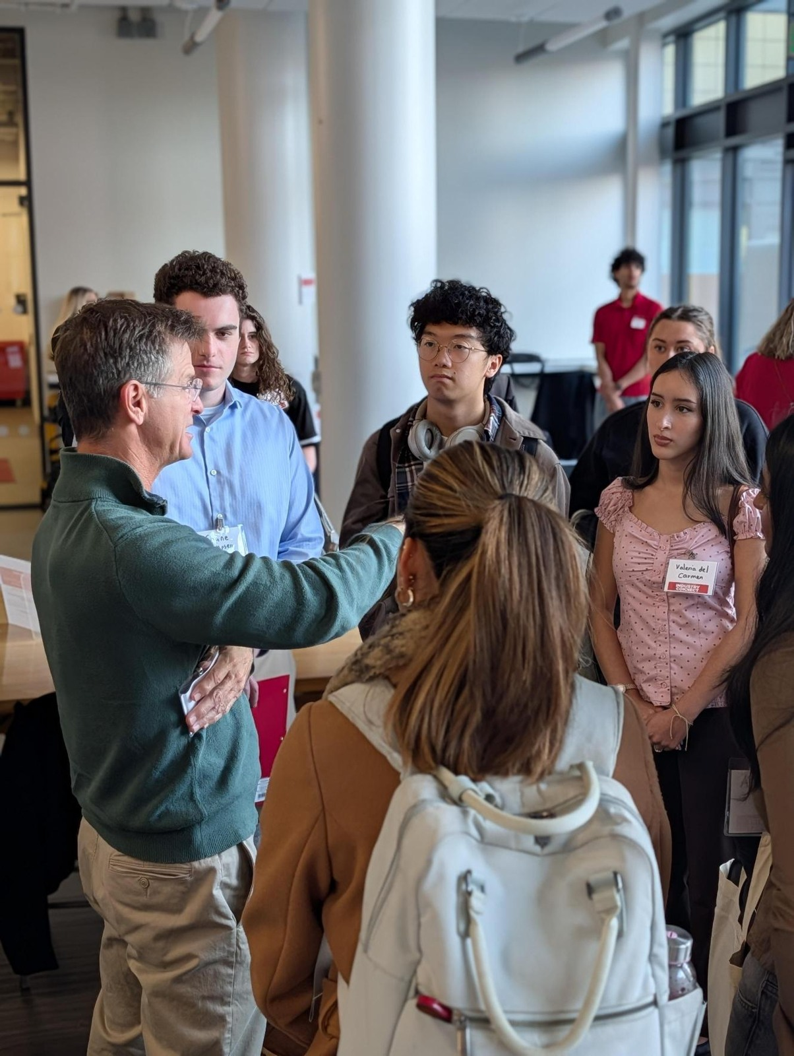
A partner check
THE CONNECTION
Does each action address the question in that phase?
THE SUPPORT
Is the resource or person a useful match?
THE REVISION
What changes if interests, circumstances, or opportunities shift?
14
Notes:
LESSON: Build Your Career Journey Roadmap
SLIDE 14 OF 16
SESSION TIMING: 33–42 minutes
FACILITATOR GUIDE
33 to 42 minutes Test and revise
Facilitator actions:
Give each partner three minutes to present two rows while the listener tests them. Use the final three minutes for both to revise and check all four phases.
Say to students:
“Explain a phase, your resource choice, your action, and how you will check progress. Your partner should ask one question that makes the plan more specific, realistic, or useful.”
Expected responses:
The listener checks phase fit, a usable resource, timing, and evidence of progress.
If students need support:
For “attend a workshop,” ask “What will you practice afterward?” For “finish discovering myself,” ask “What could you understand more clearly this term?”
Transition to the next activity:
“Keep your revised roadmap and choose the step you will take first.”
Peer check and commitment
Ask your partner: Does the action address the phase? Is the resource useful for that action? Is the timing realistic? Does the progress check show learning or movement?
My first action within seven days _______________________ Date ______________
I will revisit my full roadmap on __________________________________________
Assess the roadmap
Look for a reasonable phase connection, an action, a CES resource with a clear use, a target date, and evidence of progress in all four rows. Check that the first step is manageable. Do not grade certainty about a career or access to prestigious opportunities. A completed roadmap is a plan for learning, not proof of mastery.
SOURCE GUIDE
/Users/wj85/.codex/outputs/career-readiness-lessons/complete-library/01-career-journey-facilitator-guide.docx
SOURCES
https://careers.rutgers.edu/students-alumni/career-internship-guide
https://careers.rutgers.edu/students-and-alumni/onlinetools
https://careers.rutgers.edu/campus-partners/strategicplan-2030
PHOTO
/Users/wj85/Library/CloudStorage/OneDrive-RutgersUniversity/0 - Shared Department Files/Department-wide/Communications and Marketing/Photo Library/2026-2027 Academic Year/Industry Connect - Arts, Media, and Communications/Media (14).jpeg
Photograph is illustrative. People shown are not the fictional case participants.

Slide 15
Your first step
One action you will take this week. One resource or person who can help. One date to check what you learned.
Share your commitment. Keep your roadmap and revisit it as you grow.
Notes:
LESSON: Build Your Career Journey Roadmap
SLIDE 15 OF 16
SESSION TIMING: 42–45 minutes
FACILITATOR GUIDE
42 to 45 minutes Commit and close
Facilitator actions:
Give one minute for the exit ticket. Use two minutes to invite voluntary resource connections and briefly reinforce why they fit. This is the closing reinforcement activity; a separate quiz is not required.
Say to students:
“Name one CES resource, the phase it can help you develop, and what you will do with it. Write your first action and a date within seven days. When will you revisit your roadmap?”
Expected responses:
An explained resource connection, a specific action, and a review date.
If students need support:
If the connection is unclear, ask what the student wants to learn or do with that resource.
Transition to the next activity:
“You now have a plan you can use and revise. New learning can change the next step.”
Follow through
Ask students to revisit the plan later in the term: What did you try? What did you learn? Which resource helped? Which phase needs another action? Invite updates after a course, work experience, mentoring conversation, or a change of interests.
SOURCE GUIDE
/Users/wj85/.codex/outputs/career-readiness-lessons/complete-library/01-career-journey-facilitator-guide.docx
SOURCES
https://careers.rutgers.edu/students-alumni/career-internship-guide
https://careers.rutgers.edu/students-and-alumni/onlinetools
https://careers.rutgers.edu/campus-partners/strategicplan-2030

Slide 16
Keep building your career journey
01
CES student resources
careers.rutgers.edu/students-and-alumni
02
Online tools and resources
careers.rutgers.edu/students-and-alumni/onlinetools
03
Career & Internship Guide
careers.rutgers.edu/students-alumni/career-internship-guide
16
Notes:
LESSON: Build Your Career Journey Roadmap
SLIDE 16 OF 16
SESSION TIMING: After the closing commitment
FACILITATOR GUIDE
Resource links
CES Online Tools and Handshake access: https://careers.rutgers.edu/students-and-alumni/onlinetools
CES advising and student services: https://careers.rutgers.edu/students-and-alumni
Scarlet Career Mentoring Network: https://careers.rutgers.edu/Mentoring
Career and Internship Guide: https://careers.rutgers.edu/students-alumni/career-internship-guide
CES workshops: https://careers.rutgers.edu/events/workshops
Rutgers Internship and Co-op Course: https://careers.rutgers.edu/students-alumni/courses-signature-programs/rutgers-internship-and-co-op-course-ricc
Student Employee Enrichment: https://careers.rutgers.edu/SEE
Online Tools directs students to Rutgers Handshake resources for several tools. Check current instructions before class. Do not spend the workshop troubleshooting individual logins; students can put accessing a tool on their roadmap.
Thirty minute option
Use 0–3 for the opening, 3–7 for phase matching, 7–12 for the resource challenge, 12–23 for a first-draft roadmap, 23–28 for peer review, and 28–30 for the commitment. Use the printed menu instead of live browsing. Partners review one row each. Students still draft all four phases; ask them to refine the roadmap afterward.
Sources and resource checks
Checked November 1, 2026. The phase names and guiding questions follow the CES Career Journey graphic. The phase explanations incorporate the CES framing provided by William Jones. Resource-to-phase matches and roadmap activities are instructional recommendations. Check availability and access instructions before each session.
CES Career Journey graphic: https://careers.rutgers.edu/sites/default/files/2024-03/FourStageCounseling_2.24.22_web.png
CES Roadmap and Frameworks: https://careers.rutgers.edu/campus-partners/strategicplan-2030
CES Online Tools: https://careers.rutgers.edu/students-and-alumni/onlinetools
CES student services: https://careers.rutgers.edu/students-and-alumni
Scarlet Career Mentoring Network: https://careers.rutgers.edu/Mentoring
Career and Internship Guide: https://careers.rutgers.edu/students-alumni/career-internship-guide
CES workshops: https://careers.rutgers.edu/events/workshops
Rutgers Internship and Co-op Course: https://careers.rutgers.edu/students-alumni/courses-signature-programs/rutgers-internship-and-co-op-course-ricc
Student Employee Enrichment: https://careers.rutgers.edu/SEE
Additional reference: CES Presentation Library, 2025 CORE_CES Overview.pptx. Teaching scripts, examples, timing, and roadmap worksheets are instructional adaptations.
SOURCE GUIDE
/Users/wj85/.codex/outputs/career-readiness-lessons/complete-library/01-career-journey-facilitator-guide.docx
SOURCES
https://careers.rutgers.edu/students-alumni/career-internship-guide
https://careers.rutgers.edu/students-and-alumni/onlinetools
https://careers.rutgers.edu/campus-partners/strategicplan-2030

